Slide 1
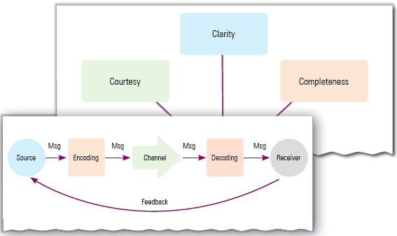
Communication Skills - 1
Unit 1

Slide 2
Learning Objectives
This Unit Covers:
Communication Cycle and its Elements
Importance of Communication Skills
Methods of Communication
Perspectives in Communication
Writing Skill

Slide 3
Introduction
Communication refers to a process of exchanging facts, ideas, thoughts, beliefs, or opinions between two or more individuals by means of verbal or non-verbal language.
It is considered as good communication, if characterized by the active participation of both the parties—speakers as well as listeners.
The process of communication includes encoding, channeling and imparting information by a sender to a receiver with the help of a medium.
Communication process is different from speaking and listening processes.
The process of speaking involves encoding the idea or message and expressing the message verbally or non-verbally.
The listening process involves hearing, decoding and understanding the message.

Slide 4
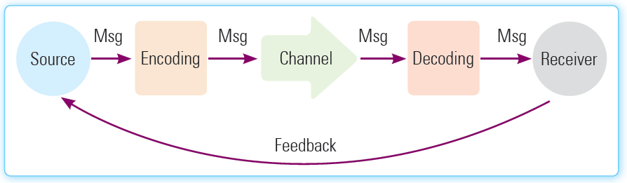
Session 1: Communication Cycle
The communication cycle is the entire process of communication in which the message is originated and sent to the right person through a proper medium.
The person who receives the message interprets the message and responds to it.
The response or feedback received from the recipient opens the way to further communication between both the parties.
The communication cycle consists of seven basic elements that are sender, message, encoding, communication channel, decoding, receiver, and feedback.
The elements of the communication cycle are shown in the following figure:

Slide 5
Session 1: Communication Cycle
The description of the elements of the communication cycle are as follows:
  Sender: Refers to a party or agent who sends the intended message to another party or agent. Sender is also referred as a source in the process of communication.
  Ideas or Message: Refers to the subject matter that the sender wishes to convey to the receiver. It may be an opinion, attitude, feeling, view, order, or suggestion.
  Encoding: Refers to a process that puts the thoughts in a framework of symbols or words.
  Communication Channel: Refers to the channel responsible for the delivery of the message. For example post office, internet and radio.
  Receiver: Refers to a party or agent who receives the sent message. The receiver is also called the audience or destination.
  Decoding: Refers to the process of deciphering the received message and understanding its intended meaning.
  Feedback: Refers to the response of the receiver to the message of the sender. This part of the communication cycle establishes a two-way communication between the receiver and the sender. It can be an acknowledgment of receiving the message or reply to the message.

Slide 6
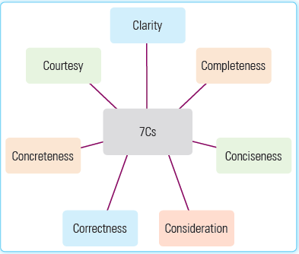
Effective Communication
Communication can be called effective only if the receiver interprets the message as desired by the sender.
For example, a business communication is called as effective, when it has seven qualities, called 7Cs or seven principles of effective business communication. Following figure shows the 7Cs:

Slide 7
Effective Communication
The description of the 7Cs are as follows:
  Clarity: Requires that a simple language should be used in communication. Moreover, the communication should be clear enough so that the receiver can easily understand the message of the sender.
  Completeness: Implies that communication should contain all the information necessary to get the desirable response from the sender. On the other hand, the sender should answer all the questions asked by the receiver and pay attention to all minute details.
  Conciseness: Implies that the message should be free from superfluous details, which helps in saving the time of both, the sender and the receiver.
  Consideration: Requires preparing the message keeping the recipient in mind. A sender, while sending the message should take into consideration the views, thoughts, background, mindset, and education level of the receiver and vice versa.
  Correctness: Implies that the message should state accurate facts and figures.
  Concreteness: Implies that the message should be specific and to the point.
  Courtesy: Constitutes one of the important elements of an effective business communication.

Slide 8
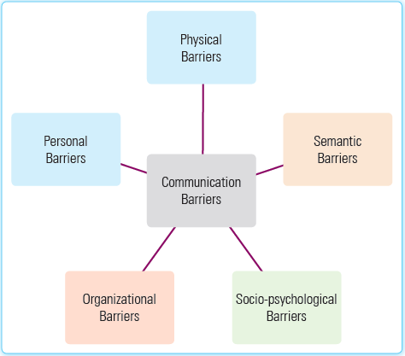
Barriers to Communication
Irrespective of the paths of communication flow, there are certain barriers that prevent the facilitation of effective communication. These barriers are called communication barriers.
Some common communication barriers are shown in the following figure:

Slide 9
Barriers to Communication
The descriptions of the barriers are explained as follows:
  Physical Barriers: Occur due to discrepancy in the perception of the receiver or the sender.
  Personal Barriers: Comprises factors, such as attitude toward superiors, colleagues and other employees working in the organization.
  Organizational Barriers: Include those communication barriers that are caused because of excessive formality and rigidness in organizational structures. Organizational barriers arise because of complexity in organizational policies, and rules and lack of communication facilities.
  Socio-Psychological Barriers: Involve factors like the psychological needs and feeling of a person, place in society, status in the hierarchical structure of the organization, differences in attitudes, family background, cultural differences, etc., are prime barriers in the communication process.
  Semantic Barriers: Refers to the difficulties that occur in communication because the same word or symbol is interpreted in different ways by different individuals. For example, in some European countries, such as Portugal, red flag indicates danger, whereas in Korea, white flag is used for the same purpose. The misinterpretation of symbols or words leads to the failure of communication.

Slide 10
Overcoming the Barriers
The various ways to overcome barriers are explained as follows:
  Choose the right medium and right time for the information to be sent.
  Right kind of language or words should be used that may have a positive effect on the receiver.
  Cultural barriers should be understood carefully and avoided as well.
  ‘Speak less, listen more,’ is a famous saying. God has given you two ears and one mouth, hence use them in that order.
  Practice empathy and you can never go wrong.
  Speak to others as you want others to speak to you.
  Be courteous to all.
  Create a synergistic environment.
  Encourage open communication to encourage subordinates to come forward and discuss related to the goals of the organization.
  Ensure that there is a two-way communication.
  Communication can never be effective without a proper feedback system in place. Therefore, seek feedback and give clarification whenever required.

Slide 11
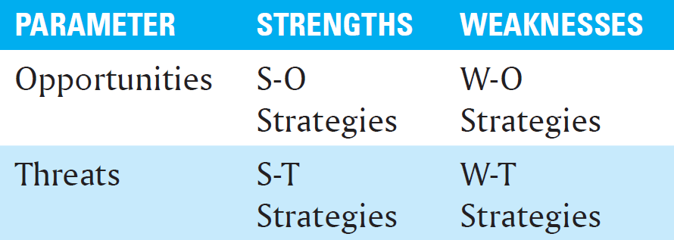
SWOT Analysis
Organizations use SWOT analysis to identify communication barriers and remove them. The term SWOT stands for:
Organizations use the SWOT analysis to identify the strengths and weaknesses of their communication network, be it formal or informal and exploit the opportunities to overcome the threats of today’s globalized era of cut-throat competition.
To develop strategies for improvement of an individual or an organization based on SWOT analysis, we can construct a matrix, as shown in the following table:
  S ⇾ Strengths
  W ⇾ Weaknesses
  O ⇾ Opportunities
  T ⇾ Threats

Slide 12
SWOT Analysis
This matrix is also known as SWOT matrix.
  S-O strategies pursue opportunities that are a good fit to the company’s strengths.
  W-O strategies help to overcome weaknesses to pursue opportunities.
  S-T strategies identify ways in which strengths may be used to overcome threats.
  W-T strategies help to establish plans to prevent weaknesses becoming susceptible to threats.
An organization may use the above strategies to create a harmonious and healthy environment to help individual and organizational goals to be achieved.

Slide 13
Session 2: Importance of Communication Skills
Good communication skills are prerequisites to one’s personal, academic, and professional success.
The basic skills required at the entry level of today’s jobs are communication skills, and this includes all aspects of communication, that is, verbal, non-verbal, as well as the listening skills.
Even for building good personal professional relations, you require good interpersonal skills for which, you need to have excellent communication skills.
In an organizational context, communication involves conveying orders, instructions, and information to achieve the desired level of performance of employees.

Slide 14
Session 2: Importance of Communication Skills
Some common one-liners frequently used in business communications are:
  Good morning/afternoon/evening. May I help you?
  Mr.... is in a conference at the moment.
  May I know who is speaking? Do you have an appointment?
  Mr.... is not available today. If you want, I can give you an appointment with him for tomorrow.
  Mr.... is out of town on business tour and won’t be back until next week. Please leave your name and telephone number. We’ll get back to you.
  Is there anything I can do to help you?
  Is that a good time for me to call you?
  I assure you it will be straightened out to your satisfaction.
  Thank you for calling.
  Thanks for your order.
  I’m glad we were able to help.
  I’m sorry, I was unable to get back to you sooner.
  Feel free to call/visit us about anything.
  We appreciate your interest in our products.

Slide 15
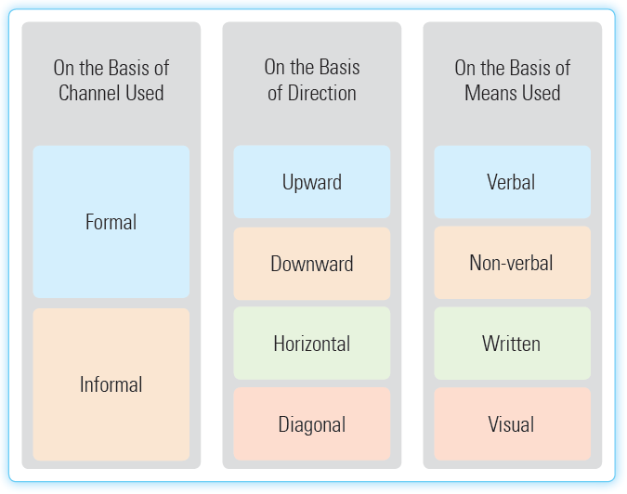
Session 3: Methods of Communication
Communication is either verbal or non-verbal, but in an organization or our daily working lives, communication can be categorized on the basis of the channel used, direction of information flow, and the means used to communicate.
Following figure shows different types of communication:

Slide 16
Session 3: Methods of Communication
The various types of communication are explained as follows:
  On the basis of channel used:
    Formal Communication: Ensures that communication should occur in a formal format or pattern that is acceptable in an organization. It can also be called business communication or corporate communication. This type of communication involves the use of meetings, conferences, corporate letters and written memos within the organization.
    Informal Communication: Includes a free and uninhibited communication between two agents, parties, or people who share a rapport with each other. Such communication needs two people who have same wavelengths or common interests. Thus, it involves communication between friends and family members.
  On the basis of direction:
    Upward Communication: Refers to the communication that flows from the lower level to upper level of organizational hierarchy. For example, when an employee makes a request or appeal, or communicates ideas to the superior, the flow of information is from bottom to top. This form of communication is called upward communication.

Slide 17
Session 3: Methods of Communication
    Downward Communication: Refers to the communication that flows from upward to downward level of organizational hierarchy. For example, when a superior issues orders and instructions to subordinates, the flow of information is from top to bottom. This form of communication is called downward communication.
    Horizontal Communication: Refers to the communication taking place among the members at the same level in the organization. For example, a marketing manager may communicate the marketing plan to the production manager.
    Diagonal Communication: Refers to the communication that takes place between individuals in different departments and at the different levels of organizational hierarchy. Diagonal communication takes place under particular circumstances. For example, a diagonal communication takes place when the head of a department at one branch of a bank communicates with a cashier of the other branch of the same bank.
  On the basis of means used:
    Verbal Communication: Takes place with the help of sounds, words and language. This communication involves the act of speaking, which is an effective way of communication. The verbal communication is broadly classified in two types: interpersonal communication and public speaking. Interpersonal communication takes place between two or more people, generally at personal level. On the other hand, public speaking involves single speaker and many audiences.

Slide 18
Session 3: Methods of Communication
    Non-verbal Communication: Refers to the kind of communication that involves various characteristics, such as tone of the voice (inflexions), smell, touch, and body motion. Such communication may involve symbols and sign languages that do not require words to be conveyed. For example, finger on lips is a sign of telling the other person to be silent.
    Written Communication: Involves the use of emails, articles, reports, and memos. Written documents need to be edited a number of times before they are conveyed to the intended individual whether within or outside the organization. Written communication may also be used for the purpose of informal communication, for example, mobile Short Message Service (SMS).
    Visual Communication: Involves the visual display of information, such as photos, formats, signs, codes, symbols, and designs. For example, television, DVDs, CDs and other audiovisual aids of communication represent visual communication.

Slide 19
Session 3: Methods of Communication
Following table analyzes the pros and cons of different types of communication on some common parameters:
Parameters | Written | Verbal | Non-verbal
Clarity/Chances of miscommunication | Clear and concise | Usually clear | Interpretation mainly depends on the audience’s perspective, which may vary from person to person
Immediate feedback | Not possible | Possible | Not possible
Record | Can be preserved for future references | No record | No record
Time consuming | Yes | No | Yes
Personal touch | No | Yes | No

Slide 20
Session 3: Methods of Communication
Parameters | Written | Verbal | Non-verbal
Cost factor | Involves cost as it makes use of paper, pen, emails, etc. | Involves much less cost as it is mostly face-to-face or telephonic. | Involves cost if the non-verbal communication involves graphics, displays, billboards, etc.
Response time | The recipient usually gets sufficient time to think about the matter and then respond | The response is often immediate. | Usually response time is more as compared to verbal communication.
Detection of exact feelings | No chance of knowing the exact feelings of the author. We assume whatever is written as true. | Any mismatches between the spoken word and the real feelings of the speaker can easily be detected by various bodily clues, such as gestures, tone of voice, etc. | Interpretation mainly depends on the audience’s perspective, which may vary from person to person.

Slide 21
Session 3: Methods of Communication
The following table lists some Do’s and Don’ts of a positive and confident body language:
DO’s | DON’TS
Do keep your body in a neutral and relaxed position. Keep your arms open as it means you are confident about yourself as well open to new ideas. | Don’t cross your arms or legs. This may send a negative message that you’re closed or negatively evaluating the situation. Others may think that you are not open to others and their ideas.
Nod your head in a ‘yes’ gesture often while listening to someone. This gesture signals that you’re in agreement and want to engage in the conversation. | Don’t overdo the nodding. Consistently bobbing your head will make you appear nuts.
Keep your hands pretty still and gently in your lap. | Don’t keep fidgeting and playing with objects. It will imply that you are nervous and not interested.

Slide 22
Session 3: Methods of Communication
DO’s | DON’TS
Smile genuinely. There is nothing better than smiling. It shows that a person is credible, confident, and trustworthy. | Don’t give a fake smile-closed mouth and no smiling eyes.
Always make an eye contact with your audience. Eye contact gives the impression of being interested and engaged in the conversation. | Don’t look down or off into space. It shows that you are not interested in the audience, or in the whole idea of being there.
Sit or stand straight and in a relaxed, but not leaning, position. | Don’t shake your legs while sitting. It shows restlessness and disinterest.
Speak with appropriate expressions on your face. Facial expressions matching with the spoken word help the audience understand the meaning of the message more clearly. | Don’t be expressionless while addressing an audience. You might pass off as a dumb and people will soon lose interest.

Slide 23
Session 4: Perspectives in Communication
Communication is a two-way process and its success depends upon a cordial and conducive attitude as well as receptivity from all the parties involved.
Some of the common factors that may affect the effectiveness of communication are shown in figure:
Visual Perception
Language
Past Experience
Prejudices
Feelings/Moods
Environmental/Physical

Slide 24
Session 5: Writing Skills
Writing can be defined as the way of representing language in visual form.
It is a creative process in which the author gives expression to his/her thoughts and ideas in a systematic or organized manner.
As the writer/author is usually separated in time and space from the audience, the written work must be very clear and precise in conveying its intended meaning.
An effective writer can communicate his/her ideas well to others. Therefore, whenever we write something, we need to be reader friendly.
Readers should be able to understand the intended meaning of texts as writing is a tool of communication.

Slide 25
Session 5: Writing Skills
Some common factors that must be considered while writing are as follows:
  Grammar for the Clarity and Correctness: Using correct grammar is an essential element in building writing skills. An article, no matter how informative, will not interest readers if there are grammatical mistakes.
  Vocabulary Building: Knowing grammar alone does not solve all the problems related to writing. One should also possess adequate vocabulary to be able to write effectively. If we do not have enough vocabulary, we will have to face difficulty in expressing our ideas in the form of written words. There are two kinds of vocabularies, which are as follows:
    Active vocabulary: Refers to the set of words that we know and use frequently while speaking or writing. For example, words, such as good, bad, fine, food, walk, and sleep are very often used by us while speaking or writing.
    Passive vocabulary: Refers to the set of words that we know, but we do not use them while writing or speaking. For examples, words such as therefore, however, and nevertheless are not frequently used by us while speaking or writing.
  Simple Spelling Rules: In addition to grammatical mistakes, we should also avoid spelling mistakes in our articles. English language has a huge number of words. There are a number of English words that have originated from different languages such as Greek, Latin, French, and Spanish.

Slide 26
Phrases
A phrase is a small group of words that forms a meaningful unit within a clause. Phrases form an essential part of English vocabulary and usually help in solving ‘fill in the blanks’ types of questions.
There are different types of phrases:
  Noun phrase: It is built around a single noun, for example, A glass of wine is on the table.
  Verb phrase: It is the verbal part of a clause, for example, Nysa had been living in India.
  Adjective phrase: It is built around an adjective, for example, She worked really hard to get this position.
  Adverbial phrase: It is built around an adverb by adding words before and/or after it, for example, The sick woman recovered very slowly.
  Prepositional phrase: It is built using a preposition, for example, I longed to live near the sea.
The word phrase is also used to refer to a short group of words having a particular meaning when they are used together, such as rain cats and dogs, play for time, or a square meal. This type of phrase is often referred to as an idiom.

Slide 27
Kinds of Sentences
Depending upon their formation and number of ideas they intend to convey, sentences are of three types: simple, compound and complex.
  Simple Sentence: Contains a subject and a verb and expresses a complete thought. It is also called an independent clause. Example: The doctor sipped his tea.
  Compound Sentence: Contains two independent clauses joined by a conjunction. Conjunctions are almost always preceded by a comma. Example: I went to my friend’s home, but he was not at home.
  Complex Sentence: Contains an independent clause (a group of words that can stand alone) joined by one or more dependent clauses. Example: When he handed in his homework, the instructor smiled.

Slide 28
Parts of a Sentence
A written sentence can be defined as an arrangement of words that help people to clearly express their ideas in writing.
It must always start with a capital letter and end with a punctuation mark (period, question mark, or exclamation point).
A sentence typically has a noun (called the subject) as well as a verb (called the predicate).
Subject is the person or thing that performs an action, or is the focus of the sentence.
Predicate is the part that contains the action. It is the part of the sentence that is not the subject, and includes all the descriptions of the action and the objects that are affected by the action.

Slide 29
Parts of a Speech
In English language, words are categorized into eight basic types, which we call parts of speech.
The different parts of speech in English language are: noun, pronoun, adjective, verb, adverb, preposition, conjunction and interjection.
  Noun: A noun is a part of speech, which is used to name a person, place, thing, animal, or abstract idea. Ex. Ram, India etc. The different types of nouns are as follows:
    Common noun: Specifies the type of noun that represents a class of place, person, or thing, that is, it does not signify the name of a single place, person, or thing. Ex. dog, cat, bat etc.
    Proper noun: Refers to the name of some particular person or place. It always starts with a capital letter. Ex. India, Japan etc.
    Collective noun: Signifies the type of noun that refers to a group of persons or things, although the noun itself is in the singular form. Ex. People, army etc.
    Abstract noun: Refers to the noun that cannot be perceived by the five physical senses. It pertains to emotion, idea, or quality that has no physical existence. Ex. Success, beauty etc.
    Countable noun: Refers to the noun that names countable things, people, etc. It has both singular form and plural form. Ex. book, pen, table etc.
    Uncountable noun: Refers to the noun that names uncountable things. Ex. Oxygen

Slide 30
Parts of a Speech
  Pronoun: A pronoun is a word that can replace a noun or another pronoun. In other words, a pronoun is a word used instead of a noun. Ex. I, We, You, He, She etc. It helps in avoiding repeated use of nouns. Pronouns are used in three different forms. These three forms of pronouns are explained as follows:
    First person: Refers to the pronouns I and we, which denote the person or persons speaking.
    Second person: Refers to the pronoun you, which denotes the person or persons spoken to.
    Third person: Refers to the pronouns he, she, it, and they, which denote the person or persons spoken of.
  Adjective: An adjective is a word used with a noun to describe the quality, quantity, characteristics, and nature of the noun that it qualifies. In other words, it adds something to the meaning of a noun. Ex. honest, large, sweet etc. Adjectives can be further divided into different classes. These are as follows:
    Adjectives of quality
    Adjectives of number
    Demonstrative adjectives
    Interrogative adjectives

Slide 31
Parts of a Speech
  Verb: A verb is a word that tells about the action or affirms something about a person or a thing. Ex. play, eat, read etc. Verb may be of two types, namely, transitive verb and intransitive verb.
    Transitive Verb: A transitive verb refers to an action that transfers from a doer or a subject to an object. It has two characteristics, namely, an action verb and a direct object.
    Intransitive Verb: An intransitive verb refers to an action that does not transfer from a doer or a subject to an object. It does not take any direct object in the sentence.
  Adverb: An adverb is a word that modifies the meaning of a verb, an adjective, or another adverb. Ex. very, quickly etc. On the basis of their use, adverbs may be of different types. These are as follows:
    Adverbs of time
    Adverbs of frequency
    Adverbs of place
    Adverbs of manner
    Adverbs of degree
    Adverbs of reason

Slide 32
Parts of a Speech
  Preposition: A preposition is a word that shows the relation of nouns, pronouns and phrases with the other words in a sentence. Ex. at, in, on etc.
  Conjunction: A conjunction is a word that is used to join different parts of a sentences, and sometimes words. Some common conjunctions are and, but, for, or, nor, yet, so etc.
  Interjection: An interjection is a word that is used to add emotion in a sentence. In other words, it expresses sudden feeling or emotion. It is not grammatically related with any other words in the sentence. An interjection is usually followed by an exclamatory mark. Ex. Hi! Bravo! Cheers! Hurrah!, etc.

Slide 33
Use of Articles
Articles are of two types—definite and indefinite. Let’s first see the logic behind the usage of the articles, ‘a/an, and the’.
‘The’ is the definite article, and is used to specify a specific or particular thing, such as The Jammu Tawi express, The Moon, etc.
‘A/An’ are indefinite articles, and are used to refer to non-specific or non-particular nouns, such as A cat, A train, An egg, etc.
For example, Tushar wants to buy a motorbike. Here, it can be any motorbike, so we should use the indefinite article ‘a’.

Slide 34
Construction of a Paragraph
A paragraph is a set of sentences focusing upon a single idea or train of thought.
Ideally, a paragraph should be around 5–7 sentences containing the topic sentence, 3–5 supporting sentence and a concluding sentence.
There should be exactly one main idea per paragraph, which means you should start a new paragraph whenever you want to introduce a new idea.
Elements that are essential to good paragraph writing are as follows:
  Unity: After introducing the main topic of the sentence, each subsequent sentence should elaborate and provide more detail to that topic, giving the paragraph unity.
  Order: The way sentences are organized in a paragraph is known as its order. For example, you can choose to write your ideas in the order of importance, chronological order, or another logical presentation.
  Coherence: It implies that every sentence in your paragraph should be logically connected to the sentence that precedes it. Coherence of ideas makes your work understandable.
  Completeness: A paragraph is called complete if all the sentences in it are clearly and sufficiently supporting the main idea.

Slide 35
Thank You

