Slide 1
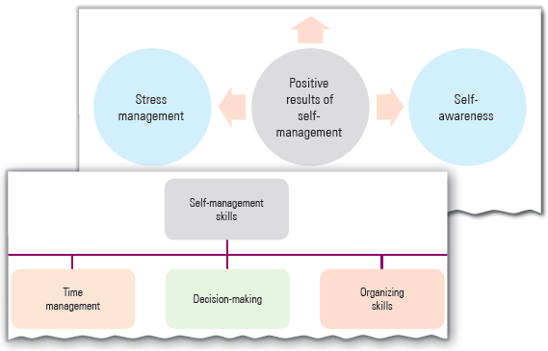
Self-Management Skills-I
Unit 2

Slide 2
Learning Objectives
This Unit Covers:
Self-Management
Positive Results of Self-Management
Self-Management Skills
Self-Confidence
Positive Factors of Self-Confidence
Self-Confidence-Building Tips

Slide 3
Introduction
Self-management refers to a process of organizing the resources and directing the efforts for the successful accomplishment of the individual goals and objectives.
The main objective of self-management is to draw maximum output out of minimum efforts by an individual.
Self-management can be effective when an individual functions stress-free and saves time; which, in turn, increases the overall individual productivity.
An essential self-management skill is self-confidence, which refers to overall efficiency of an individual which depends on the self-belief, skills and abilities.
Self-confidence helps an individual to work towards the fulfillment of personal and professional goals and objectives.
It also includes integrating and synchronizing individual resources in such a manner that the individuals can achieve their purposes.

Slide 4
Session 1: Self-Management
Self-management can be defined as the application of skills and strategies that help an individual throughout his/her life to achieve goals and objectives and become more productive.
Advantages of self-management are as follows:
  It helps an individual to make the best possible use of abilities, skills and knowledge.
  It motivates an individual to contribute optimally towards the achievement of goals.
  It makes an individual more organized and, thus, easier for him to work.
  It gives an individual the confidence to handle the situation in an effective and efficient manner.
  It helps an individual to show positive attitude towards the responsibilities in both personal and professional lives.
  It helps an individual to manage time, stress and priorities.

Slide 5
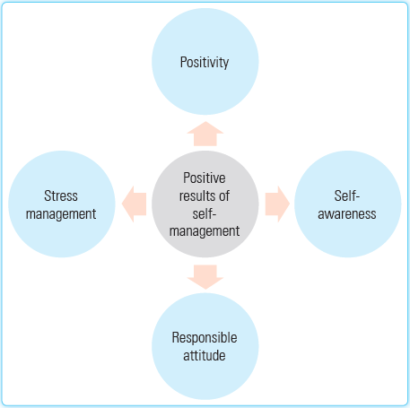
Session 2: Positive Results of Self-Management
Self-management is a skill that becomes essential for the achievement and success of an individual.
The positive results of self-management are shown in the following figure:

Slide 6
Session 2: Positive Results of Self-Management
The description of the positive results of self-management are as follows:
  Positivity: Self-managed individuals always keep their eyes on the goals and do something on a daily basis to achieve those goals. They take every problem of their personal and professional lives positively and try to find out the solution with lots of enthusiasm and confidence.
  Self-awareness: Individuals with self-awareness have an ability to observe themselves from an objective viewpoint. It is the individual’s ability to recognize and understand his/her strengths, weaknesses, emotions and limitations in order to enhance the credibility and leadership qualities.
  Stress management: It is a skill of controlling and managing an individual's level of stress and making the activities of life more organized. Stress management can be carried out using various methods like meditation, self-talk and regular exercise to develop the ability to resist stress.
  Responsible attitude: It is associated with showing acceptable behavior in personal and professional lives as well in the society. It helps the individual to recognize his/her main objectives of life and develop the responsibility, to learn and improve skills to achieve the objectives and to understand the responsibility of his/her own action.

Slide 7
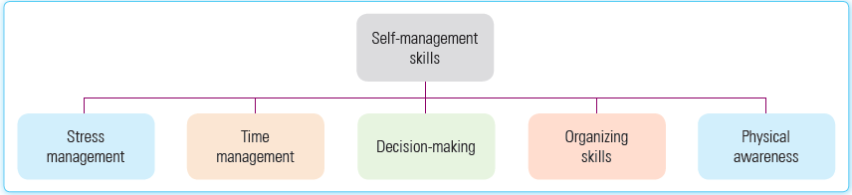
Session 3: Self-Management skills
Self-management skills are those skills that help an individual become more productive in his/her personal as well as professional lives.
These skills help him to avoid stress, to manage time well, to become more confident and to take better decisions.
Self-management skills help an individual in the process of creating and maintaining an environment in which he works to achieve the predefined goals by making an optimum utilization of all the available resources.
The self-management skills are shown in the following figure:

Slide 8
Session 3: Self-Management skills
The description of the self-management skills are as follows:
  Stress management: It is an individual’s ability to control and manage any difficult and hard situation. It helps in improving both physical as well as mental health and increasing focus, which, in turn, motivates an individual to achieve the set goals.
  Time management: It is a process of planning and scheduling time among different tasks in order to maximize the productivity of an individual. The main objective of time management is to get more work done in lesser period of time with little or no stress at all.
  Decision-making: It is a process of making decisions between two or more things and actions. It requires the knowledge and information to analyze the situation to identify all the options and possibilities to achieve a specified goal. It refers to the quality of an individual that enables him to be confident about his/her decisions.
  Organizing skills: It is the combination of planning, prioritizing, motivation and time management. It helps an individual to develop a time table, arrange tasks, improve efficiency and set priorities.
  Physical awareness: It helps an individual to increase his/her level of physical activity in order to improve his/her physical health, to make him more productive and to boost the power of the body and mind.

Slide 9
Session 4: Self-Confidence
Self-confidence can be defined as a belief in one’s personal abilities, potentials and strengths. It means someone is self-assured about his/her skills and capabilities to achieve goals and objectives.
Self-confident people are generally assured of themselves and their abilities, take risks and challenges, do not hesitate to try new things and think about their future positively.
It is a positive attitude that the individuals hold about themselves that allows them to achieve their objective and also helps to keep moving forward in personal and professional lives.

Slide 10
Session 5: Positive Factors of Self-Confidence
Self-confidence is the strength which an individual can achieve by combining the state of mind and feeling of self-faith, which give the individual self-assurance about his/her skills and abilities.
The three most important factors of self-confidence are as follows:
  Social factor: It is a feeling of affection, belongingness, acceptance and friendship in the society and family. Self-confidence rises when we feel accepted in our personal and professional lives by the people and it falls when we feel rejected.
  Cultural factor: It helps an individual build up his/her confidence level, self-image and self-respect and can also be the reason for low self-confidence and self-esteem.
  Physical factor: It refers to the physical health, personality and appearance that help one look more confident. It also helps to improve attitude and self-esteem.

Slide 11
Session 6: Self-Confidence-Building Tips
Self-confidence is the belief in one’s capabilities in carrying out the passion.
It refers to the faith of an individual about his/her skills and abilities that enable him/her to be more confident about his/her decisions, positive thinking and physical health.
Self-confidence makes an individual confident in order to achieve his/her goals and objectives.
Some tips to build self-confidence are as follows:
  Negative thinking: Negative thinking is one of the most important reasons of low self-confidence that is created in one’s mind. Sometimes we have personal and emotional issues which we do not share with anyone and it gradually converts into negative thoughts. So, talking to and sharing feelings with people and family members help us get rid of negative thoughts.
  Positive thinking: Positive thinking can be defined as the positive attitude in which you hope for appropriate and beneficial results. It also helps to enhance your self-confidence because low self-confidence constantly brings you down and fills your mind with negative thoughts.

Slide 12
Session 6: Self-Confidence-Building Tips
  Staying happy with small things: Self-confidence actually lies in small things that help you stay happy. There are several small things that make you more confident and have great self-worth, such as dressing, dancing, smiling, running, meditating, reading and going out.
  Staying clean, hygienic and smart: Self-confidence can be improved by enhancing your personal appearance through simple steps like wearing clean clothes, shaving and bathing and practicing good hygiene regularly. Staying clean, hygienic and smart can also help you improve your perception about yourself over time.
  Chatting with positive people: Chatting with positive people gives you an ability to regulate feelings and sentiments, boost confidence, eliminate negative thoughts and helps to stay positive. It also helps you build up your confidence level.

Slide 13
Thank You

