Slide 1
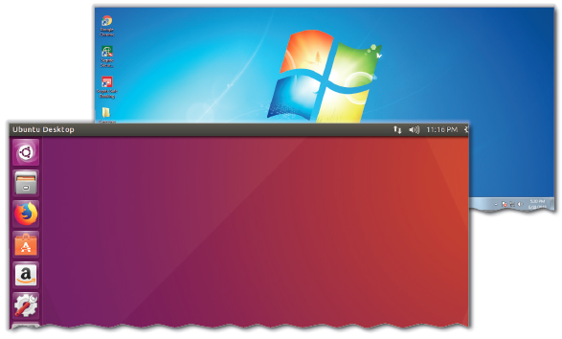
Basic ICT Skills – I
Unit 3

Slide 2
Learning Objectives
This Unit Covers:
Role and Benefits of ICT
ICT Tools
Basic Components of a Computer System
Operating System
Common Desktop Operations
Working with Files and Folders
Starting and Shutting Down a Computer
Internet
Email Applications
Introduction to Social Media
Digital India

Slide 3
Introduction
Information and Communications Technology (ICT) can be regarded as the extension of IT as it involves the integration of IT with media transmission and broadcasting technologies.
In the past few decades, Information Technology (IT) has brought a revolution in the computing and communication fields.
Today, thanks to the Internet, you can send or receive information almost about any topic in just a few seconds from any corner of the world.
The Internet also allows you to communicate with a person or a group of people simultaneously in a real-time environment.
Innovations in the IT field have affected many areas of our daily life, such as education, entertainment and health.
The revolution in the IT sector has also created many new careers in the field of software and engineering.
However, despite its numerous advantages, the IT sector poses serious problems in the form of ethical and other issues arising due to the misuse of its assets and products.

Slide 4
Session 1: Role and Benefits of ICT
ICT is known as Information and Communications Technology, which emphasizes on imparting knowledge in the field of education.
It helps individuals or institutions handle information by using computers and other digital technologies.
ICT promotes usage of audio-visual equipment for imparting knowledge majorly at the school or college level.
With the passage of time, ICT has proved to be an essential and basic step in the development of the modern society.
In many countries, the learning of the concepts of ICT is considered as an important part of education.
ICT has wide scope in various fields, such as education, health care, governance, design and manufacturing and business.

Slide 5
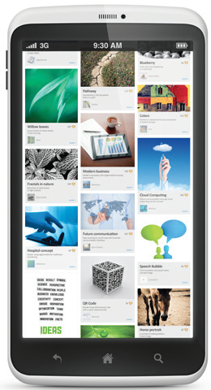
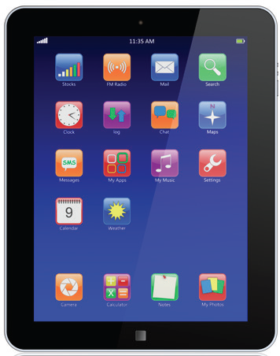
Session 2: ICT Tools
Some commonly used ICT tools are mobile, tablet, radio, television and email.
These tools help in the communication and broadcasting of information.
The description of these tools are as follows:
  Mobile Phone: A mobile phone is a device that helps you in performing different tasks such as making and receiving phone calls, sending or receiving messages, making video calls, etc. Today, mobile phones are smart phones which can perform almost every task that a computer can perform. The given figure shows a smartphone.
  Tablet: A tablet is a type of portable computer which has a flat surface and can be operated by using your fingers or a special pen. It has memory for storing data and can also be used to run Internet and make calls. The tablet computer has an internal battery which needs to be charged from time to time. The given figure shows a tablet.
Smartphone
Tablet

Slide 6
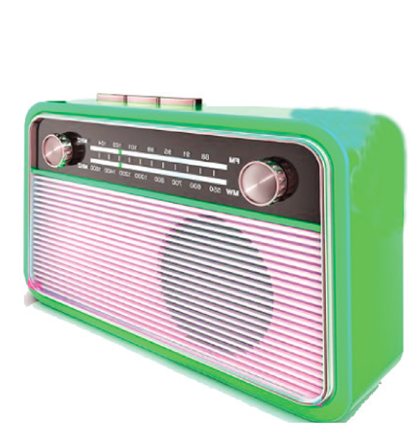
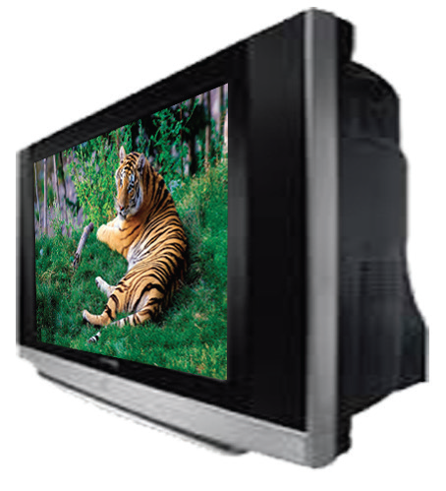
Session 2: ICT Tools
  Radio: A radio is a wireless device that receives signals in the form of electromagnetic waves from space and transmits them in the form of sound. It is beneficial of sending information to those areas where visual communication is still not feasible. The given figure shows a radio.
  Email: Email and chatting services are also important ICT tools. In email service, the messages are sent from one computer to another using Internet. Email is a good medium for students to communicate outside with others outside their school.
  Television: A television is a device that is used to transmit information in the form of moving images along with sound to its viewers. The given figure shows a television.
Radio
Television

Slide 7
Session 3: Basic Components of a Computer System
A computer is an electronic device which is used to perform a variety of operations on the basis of a set of instructions called program.
The various components of a computer are as follows: the input unit, the processing unit, the output unit and the storage unit.
An input device takes input from the user and displays the result through an output device.
The unit that processes the input to generate output is called the processing unit.
The unit that stores all the data and information of a computer system is known as the storage unit.
The physical components of a computer system, such as keyboard, mouse and monitor, are termed as hardware.
The programs or applications that provide instructions to a computer to carry out a particular task are known as software.

Slide 8
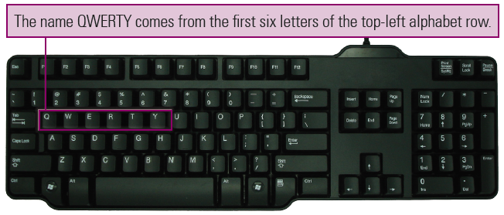
Input Devices
The devices that let you enter data or instructions in a computer are known as input devices.
The various types of input devices are as follows:
  Keyboard: A computer keyboard looks like a typewriter. Besides the normal alphabet keys, it also has a numeric keypad located to its right. The keyboard that we use is also known as the QWERTY/Universal keyboard. Generally, keyboards are available in two models – standard model with 83–84 keys and enhanced model with 101 or more keys. This model of the commonly used enhanced model Windows keyboard contains 104 keys. The following figure shows a keyboard having 104 keys:

Slide 9
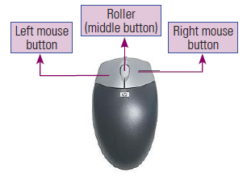
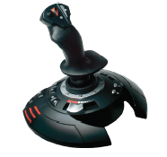
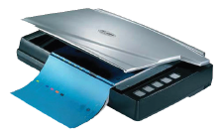
Input Devices
  Mouse: A mouse is a basic input device of a computer. It controls the movement of the cursor or pointer on the display screen. As you move the mouse on a plain surface, the pointer on the display screen also moves in the same direction. A mouse may contain either two or three buttons. Each mouse button is used to perform different mouse operations.
  Joystick: A joystick is a hand-held device that is used to control the movement of the cursor or other graphic elements in video games. You can move a joystick in four directions: left, right, up and down.
  Scanner: A scanner is an input device that scans images, printed text, or an object and converts it into a digital image. Instead of making a duplicate copy on a paper, the scanner stores the digital image in the computer memory.
Mouse
Joystick
Scanner

Slide 10
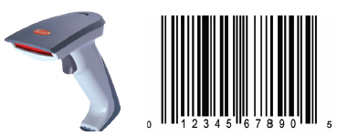
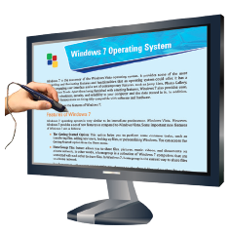
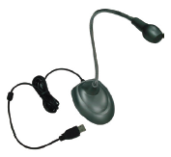
Input Devices
  Bar Code Reader: A bar code reader is an input device that is used to read the information encoded on a bar code. The bar code reader is also known as a price scanner or point-of-sale (POS) scanner. A bar code is an optical machine-readable code, which is printed on various types of products. It holds the necessary information about the product.
  Light Pen: A light pen is a pointing device that uses a photoelectric (light-sensitive) cell to indicate a position on the computer screen. When you keep the pen in front of an icon of the computer screen, say the Start button, it senses the light and the photoelectric cell gets activated.
  Microphone: A microphone is an input device that records voice or sound and transforms the recorded voice into digital data so that a user can play back or edit the digitized voice as required.
Barcode Reader and pattern
Light pen
Microphone

Slide 11
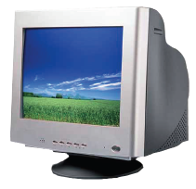
Output Devices
An output device is an electronic equipment that is connected to a computer and is used to communicate results of the processed data to the user.
Monitor is one of the most common output devices that is used to display the results of the processed data, i.e., the computer output.
Apart from the monitor, the computer output can also be retrieved through other output devices, such as printer and speaker.
These provide the output received from the computer in various forms, such as text, image, sound, or any other media.
Some of the output devices are as follows:
  Monitor: The term ‘monitor’ is often used to refer to a computer screen as it displays programs, allowing the user to interact with the software. The picture that is displayed on the monitor is made up of thousands of tiny colored dots called pixels. When a program is executed, the information is displayed on the monitor. The following are the three types of monitors:
    Cathode Ray Tube (CRT): This monitor is heavy, thick and has a picture tube.
CRT Monitor

Slide 12
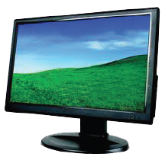
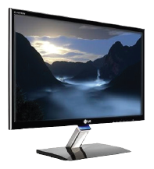
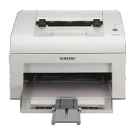
Output Devices
    Liquid Crystal Display (LCD): An LCD monitor is one of the most widely used flat panel monitors. It is more popular as a display device as compared to the CRT monitor because of its economical power consumption, thinness and high resolution.
    Light Emitting Diode (LED): An LED monitor is one of the most widely used monitors nowadays. It uses the LED technology for generating images on the monitor screen. The ability of a standard LED monitor to consume up to 40% less power than a standard LCD monitor makes it more efficient to use.
  Printer: A printer is an output device that prints the data processed by a computer. After creating a document on a computer, you can send the document to the printer for printing. The printer generates a hard copy of the document, known as printout. It can print documents in color as well as in black and white. The speed of a printer is normally rated either by pages per minute (ppm) or by characters per second (cps).
LCDMonitor
LED Monitor
Printer

Slide 13
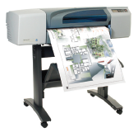
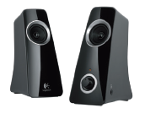
Output Devices
  Plotter: A plotter, similar to a printer, produces a hard-copy output. Plotters are generally more expensive than printers. Plotters are ideal for engineering, drafting and many other applications that require intricate graphics. Plotters do not use toner or ink to draw an image. Instead, they use a special kind of pen controlled by the motors to draw an unbroken line on the paper.
  Speaker: A speaker is an output device that produces sound. It receives sound in the form of an electric current from a sound card and then converts it into the sound format. While buying a speaker, ensure that it has a built-in amplifier and is magnetically shielded so that it does not interfere with the picture quality of the monitor.
Plotter
Speaker

Slide 14
Memory
Memory is the area where you can store information. The following is the description of the units of memory in a computer:
  1 Byte (B) = 8 bits
  1 Kilobyte (KB) = 1,024 bytes
  1 Megabyte (MB) = 1,048,576 bytes = 1024 KB
  1 Gigabyte (GB) = 1,024 megabytes
  1 Terabyte (TB) = 1,024 gigabytes
  1 Petabyte (PB) = 1,024 terabytes
  1 Exabyte (EB) = 1,024 petabytes
  1 Zettabyte (ZB) = 1,024 exabytes
  1 Yottabyte (YB) = 1,024 zettabytes
  1 Brontobyte = 1,024 yottabytes
  1 Geopbyte = 1,024 brontobytes
There are two types of memories available in your computer—primary memory or main memory and the secondary memory.

Slide 15
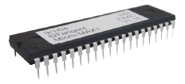
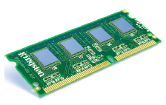
Primary Memory
Primary memory is the main memory in a computer system where data is stored for quick access by the CPU. This type of memory stores the data temporarily.
The CPU is associated with the following two types of primary memories:
  Read-Only Memory (ROM): ROM is a built-in computer memory containing data that normally can only be read but not changed. ROM contains the start-up instructions for the computer. The data stored in ROM is not lost when the computer power is turned off. ROM is sustained by a small long-life battery in your computer. The given figure shows a ROM:
  Random-Access Memory (RAM): RAM is the main memory used in a computer system. RAM stores instructions from the operating system, application programs and data to be processed, so that they can be quickly accessed by the computer’s processor. However, data stays in RAM only as long as your computer is turned on. When you turn the computer off, RAM loses its data. The given figure shows a ROM:
ROM
RAM

Slide 16
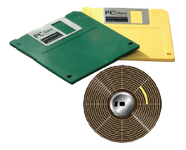
Secondary Memory
  Secondary memory are used to store data permanently. The secondary memory is also known as secondary storage.
  The storage capacity of secondary memory devices is measured in terms of Kilobytes (KBs), Megabytes (MBs), Gigabytes (GBs) and Terabytes (TBs).
  The different types of secondary storage devices are as follows:
  Floppy Disk: A floppy disk is the oldest type of secondary storage device that is used to transfer data between computers as well as store data and information. A floppy disk, made up of a flexible substance called Mylar, consists of a magnetic surface that allows data storage. Its structure is divided into track and sectors. A track of a floppy disk consists of concentric circles, which is further divided into smaller sections called sectors. The data is stored in these sectors. The maximum storage capacity of a floppy disk is 1.44 MB. The given figure shows a floppy disk:

Slide 17
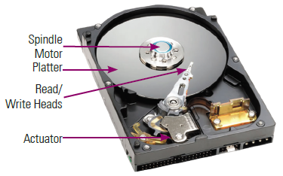
Secondary Memory
  Hard Disk: The hard disk in your system is known as the data centre of the PC. It is used to store all your programs and data. The hard disk differs from other storage devices on three counts– size, speed and performance. The given figure shows a hard disk.
  Common elements of a hard disk are described as follows:
    Platters: The platters are the actual disks inside the drive that store data. Most drives have at least two platters. The larger the storage capacity of the drive, the more platters it contains. Each platter can store data on each side. So, a drive with 2 platters has 4 sides to store data.
    Spindle and Spindle Motor: The platters in a drive are separated by disk spacers and are clamped to a rotating spindle that turns all the platters together.
    Read/Write Heads: The read/write heads read and write data to the platters.
    Head Actuator: All the heads are attached to a single head actuator or actuator arm that moves the heads around the platters.

Slide 18
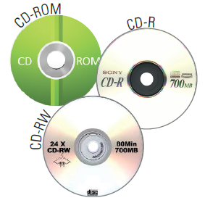
Secondary Memory
  Compact Disc: A compact disc, also known as CD, is an optical media that is used to store digital data. The compact discs are cheaper than other storage devices, such as hard disk or RAM. The compact disc was developed to store and play back sound recordings. However, later on, it came to be used as a data storage mechanism. CDs are categorized into the following types: CD-ROM, CD-R and CD-RW:
    CD-ROM (Compact Disc-Read Only Memory): A CD-ROM is an optical disc that is primarily used to store data in the form of text, images, audios and videos. The data available on such discs can only be read by using a drive, known as CD-ROM drive. The maximum storage capacity of a CD-ROM disc is 700 MB of data.
  The given figure shows the CD-ROM, DR-R and CD-RW disc.
    CD-R (Compact Disc-Recordable): A CD-R has the ability to create CDs, but it can write data on the discs only once. The data once stored in these discs cannot be erased. The CD-R technology is sometimes called the Write Once-Read Many (WORM) technology.
    CD-RW (Compact Disc-Rewritable): CD-RW (sometimes called Compact Disc-Erasable) is used to write data multiple times on a disc. CD-RW discs are good for data backup, data archiving, or data distribution on CDs.

Slide 19
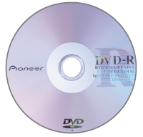
Secondary Memory
  Digital Versatile Disc: A Digital Versatile Disc, also known as DVD, is another optical storage device that was developed in 1995. A DVD can hold up to 4.7 GB data and is much faster than the CD-ROM. A DVD, also known as Super Density Disc, can store 17 GB of data. The given figure shows the DVD.
  The following are three categories of DVDs:
    DVD-R: DVD-R uses the WORM technology and is similar to CD-R. DVD-R discs are available in 4.7 GB and 9.4 GB capacities. The data is written on the disc only once. The disc can be read by DVD-ROM drives only.
    DVD-ROM: DVD-ROM is an optical disc that is capable of storing data from 4.7 GB up to 17 GB. Earlier, you could play a DVD only on a DVD player. However, nowadays, computers come with a built-in ROM to play DVDs. Moreover, now DVDs also serve as a high-capacity data storage medium.
    DVD-RW: DVD-RW (DVD-Rewritable) is similar to DVD-R except that you can erase and rewrite information on it. DVD-RW uses 4.7 GB discs and most DVD-ROM drives and DVD players support this format. The phase-change technology of DVD-RW is similar to the phase-change technology of CD-RW. The DVD-RW discs can be written multiple times. This technology is sometimes known as DVD-R/W.

Slide 20
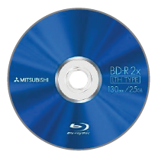
Secondary Memory
  Blu-ray Disc: Blu-ray (also known as Blu-ray disc or BD) is an optical disc storage medium. The Blu-ray disc was developed by Blu-ray Disc Association (BDA). It is used to record, store and play back high definition video (video system of higher resolution), digital audio and computer data. To read and write data, the Blu-ray uses blue-violet laser. The Blu-ray disc has the storage capacity to hold data up to 25 GB on its single-layer disc and 50 GB on the dual-layer disc. The given figure shows a Blu-ray Disc.
  The different types of Blu-ray discs are as follows:
    BD-ROM: It specifies that the disc is read-only and no data writing can be done.
    BD-R: It specifies that the disc can only be used to record high definition (HD) video and data storage.
    BD-RW: It specifies that data on the disc can be rewritten many times.
    BD-RE: It specifies that the disc can be used to rewrite HD video.

Slide 21
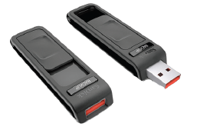
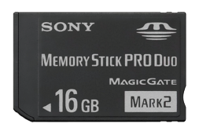
Secondary Memory
  Pen/Thumb Drive–Flash Memory: A pen drive is a data storage device. It is also known as a Universal Serial Bus (USB) flash drive. It is more compact and faster than other external storage mediums and stores more data. USB flash drive mainly comes in two variants, that is, USB 2.0 and USB 3.0. USB 3.0 flash drive works faster than USB 2.0.
  Memory Stick: A memory stick is a removable flash memory card that is used in electronic products, such as mobile phones and digital cameras. It is used to store data, such as text, images, pictures and audio/video. It was launched by Sony in October 1998. The original memory stick design had a 128 MB limitation. Generally, memory cards are small, lightweight, removable and rewritable. Memory cards are faster and highly efficient.

Slide 22
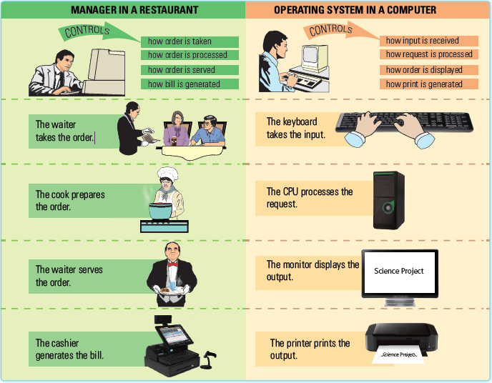
Session 4: Operating System
The software that controls and manages the hardware is known as the operating system (OS).
OS enables a user to conveniently handle the computer and make the best use of its hardware.
A user simply gives a command to the OS, i.e., he/she specifies what should be done and the OS decides how and when the tasks should be done.
Following figure displaying the Analogy between the Working of a Restaurant Manager and an OS:

Slide 23
Need of an Operating System
Operating system manages and coordinates the functions of all the components of a computer – both hardware and software.
The hardware in a computer provides resources for performing the basic computing tasks.
It is the job of the operating system to control and coordinate the use of the hardware so that the computing tasks can be performed with the help of various application software installed on the computer.
Operation system performs the following basic and important operations in the computer:
  It recognizes the input entered by the user (such as a key press or a mouse click).
  It displays the generated output on the computer screen.
  It keeps a log of the files and directories on the hard disk.
  It manages the various peripheral devices of the computer (such as printers and scanners).

Slide 24
Commonly Used Operating Systems
Some of the popular operating systems are as follows:
  DOS: DOS refers to Disk Operating System and is also known as MS-DOS. This operating system was developed by Microsoft for IBM-compatible personal computers.
  Windows: The term ‘Windows’ collectively represents all Microsoft OS products. Over the years, Microsoft has released various versions of Windows OS, such as Windows 95, Windows 98, Windows 2000, Windows XP, Windows Vista, Windows 7, Windows 8, Windows 8.1 and Windows 10.
  UNIX: UNIX was first developed in 1969 by Ken Thompson, Dennis Ritchie and others of the AT&T group at Bell Laboratories. It was among the first operating systems to be written in a high-level language, namely C. UNIX is a multiuser and multitasking operating system, which means that it allows two or more users to execute several programs simultaneously.
  Linux: Linux is a UNIX-based, freely distributable, open-source OS. Open source refers to a program whose source code is freely available on the Internet. This source code is open to modification by anyone who uses it. UNIX, Linux and GNU are three OSs based on an open-source code.

Slide 25
Commonly Used Operating Systems
  Mac: Mac OS is GUI-based OS developed by Apple Inc. This OS was introduced for Macintosh operating systems so that Macintosh users could experience the graphical user interface. The Mac OS was introduced in 1984 and was initially named Macintosh System Software, which was later renamed as Mac OS.
  Solaris: It is a UNIX-based operating system that was originally produced by Sun Microsystems. Solaris is considered a successor of the Sun operating system. Sun Microsystems has historically dominated the UNIX market. With the growth of the Internet in the early 1990s, Solaris became the most widely used servers for websites.

Slide 26
Introducing Desktop Environment of Operating Systems
The word ‘desktop’ means a desk where you put all the things required by you. For example, your desk may contain a pen-stand, a writing board, color pens, copies and books.
Similarly, the desktop of an operating system contains more or less the same things, such as files, folders and clock.
The desktop is a graphical screen that contains some icons.
These icons are used to instruct the operating system to perform various tasks, such as opening application windows or launching different applications.

Slide 27
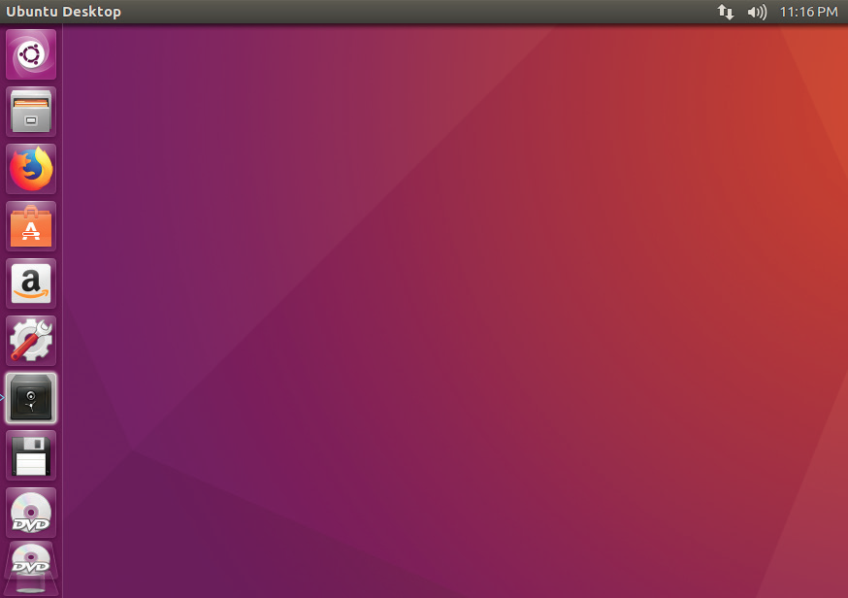
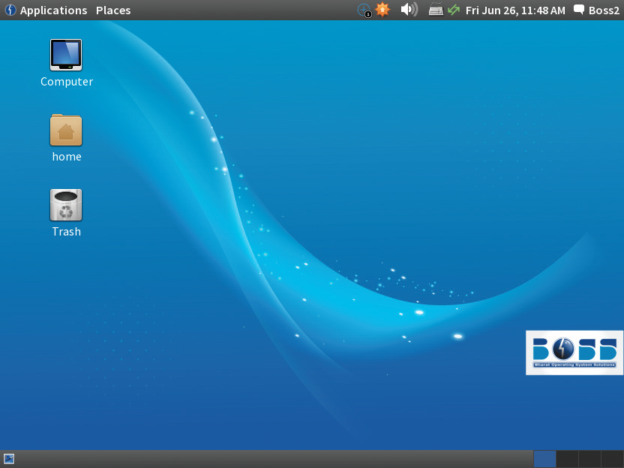
Linux Desktop
The desktop of Linux operating system may contain a wallpaper in the background, one or more active windows, top and bottom bars and icons, as shown in following figure:
A desktop background can be a single-color screen or any interesting image. All windows and icons appear at the top of the desktop screen.
Two popular graphical Linux desktops are: the GNU Network Object Model Environment (GNOME) desktop and the K Desktop Environment (KDE) desktop.

Slide 28
Linux Desktop
Some components of a desktop environment are as follows:
  Window manager: Determines the behaviour of application windows.
  Panels: They are displayed on the edges of the screen and generally contain the system tray, menu and quick launch icons.
  Menus: Consist a set of options that help you to find information or execute a program function.
  Widgets: Display useful information on various subjects, such as the weather, news snippets or system information.
  File Manager: Helps you to navigate to the files or folder on your computer.
  Browser: Helps you to browse information on the Internet.
  Office Suite: Enables you to create documents, spreadsheets and presentations.
  Text Editor: Helps you to create or edit text files.
  Terminal: Provides access to the command line tools.
  Display Manager: Enables you to logging into your computer.

Slide 29
Linux Desktop
Apart from the listed major components, the Linux operating system desktop also contains the following objects:
  Computer icon: It provides you access to removable media, such as floppies and CDs.
  Home icon: It refers to the folder where all the personal files of the user are kept. It is labelled as username’s Home. This folder can also be accessed through the Places menu on the top bar of the GNOME desktop.
  Trash icon: It refers to a location that consists of different files and folders that have been deleted by the user and are no longer needed. However, the files that are moved to the trash can also be restored when they are required.
  Additional icons: These refer to the icons that are displayed on the desktop when a CD, a removable media or an external device is inserted.

Slide 30
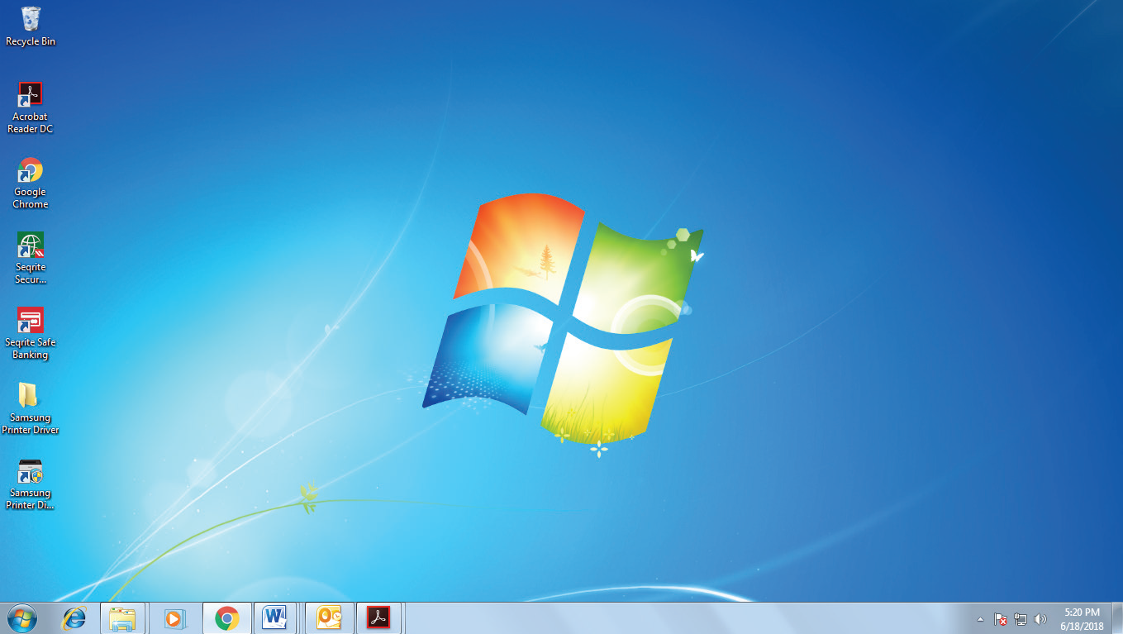
Windows Desktop
The desktop of Windows 7 is the fundamental area where you can perform several operations and tasks, such as opening an existing file and creating a new file.
It presents a medium that not only appeals to the eyes but also allows faster access to the programs and files on your computer.
Following figure shows Windows 7 desktop:

Slide 31
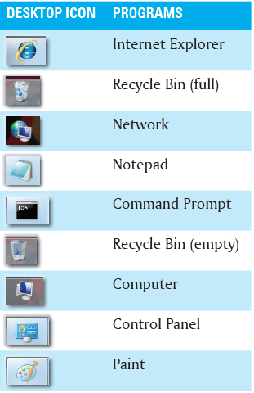
Windows Desktop
The desktop of Windows 7 consists of the following visual elements:
  Desktop Icon: It refers to small images that signify various items, such as programs, folders or files on the desktop.
  Taskbar: It refers to the long horizontal bar at the bottom of the desktop. The taskbar allows you to access various programs, certain computer-specific settings and some commonly used tasks.
The desktop icons have a textual label that appears right below them.
Labels give a short description about the program that the icon represents.
The desktop icons allow you to open or start the corresponding programs directly by double-clicking them.
Some of the most common desktop icons and their corresponding programs are listed in the following table:

Slide 32
Session 5: Common Desktop Operations
There are a number of operations that can be performed on the desktop of a computer.
Keyboard and mouse play a vital role in performing these operations.
Some of the operations that can be performed commonly on the desktop of a Windows computer are as follows:
  Adding Icons to the Desktop
  Adding Shortcut Icons on Desktop
  Hiding Desktop Icons
  Adding Gadgets on Desktop

Slide 33
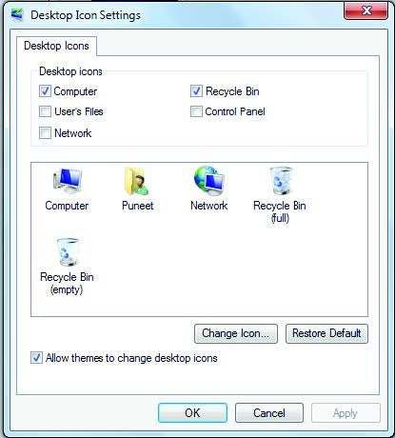
Adding Icons to the Desktop
You can add any number of icons to the desktop. However, the icons that you use more often are the ones representing programs, such as computer, network, recycle bin and browser.
You can add an icon to your desktop by using the Desktop Icon Settings dialog box, as shown in the given figure.
This dialog box is accessed by right-clicking anywhere on the empty space of your desktop and then click the Personalize option from the context menu. Now, click the Change desktop icons link available in the left pane of the Personalization window.

Slide 34
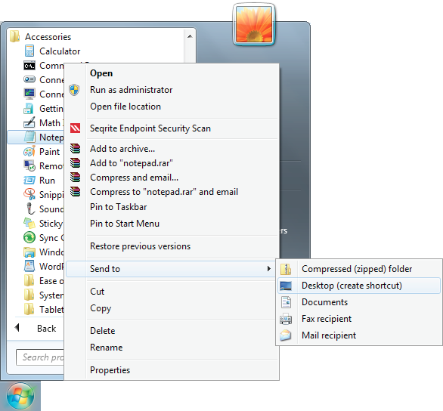
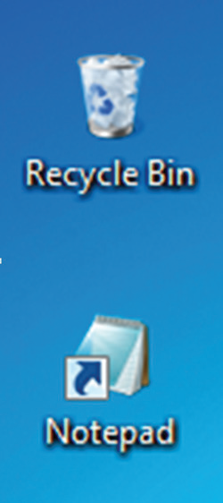
Adding Shortcut Icons on Desktop
You can add shortcut icon of a file, folder or application on your desktop by right-clicking the particular element and then Select Send to ⇾ Desktop (create shortcut) from the context menu.
The following figures shows the way to creating and displaying a shortcut Icon of Notepad program on your desktop:
Creating a Shortcut Icon
Displaying a Shortcut Icon

Slide 35
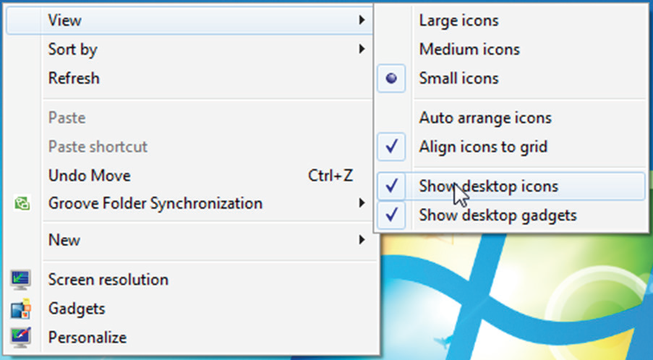
Hiding Desktop Icons
It is possible that sometimes you may want to have a clean desktop without any icon. In such a situation, you can hide all the desktop icons.
You can hide a desktop icon by right-click anywhere on the empty space on the desktop and then select the View → Show desktop icons option from the context menu in such a way that the checkmark in front of the Show desktop icons option is cleared, as shown in following figure:
This will clear your desktop by hiding all the desktop icons.
You can later unhide the icons on your desktop by selecting the Show desktop icons option such that a checkmark appears in front of this option.

Slide 36
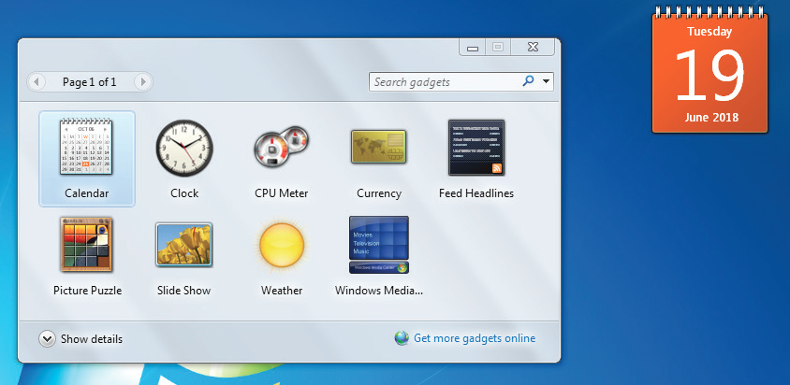
Adding Gadgets on Desktop
To add gadgets on your desktop, you need to double-click the gadget in the Windows Gadgets Gallery window, as shown in the given figure.
You can access this window by right-click anywhere on your desktop and then select the Gadgets option from the context menu.

Slide 37
Session 6: Working with Files and Folders
In computer terminology, a file is similar to a paper sheet and a folder is similar to a book. As a book contains pages, a computer folder consists of files.
Windows 7 allows you to organize your files and folders according to your preferences.
To arrange your documents, you can store the related files in one folder.
In addition, you can move, copy and search the files and folders with the help of mouse and keyboard.

Slide 38
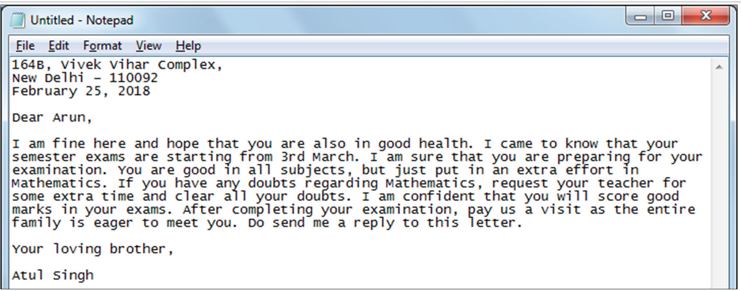
Creating and Saving a File
A file is created in a computer to record different types of data which can be either textual or graphical or a combination of both.
You can create a file (in our case Notepad file), by clicking All Programs → Accessories → Notepad in the Start menu.
Now, enter some information in the opened notepad file, as shown in the following figure:
After entering text in the file, you need to save the file for future usages.

Slide 39
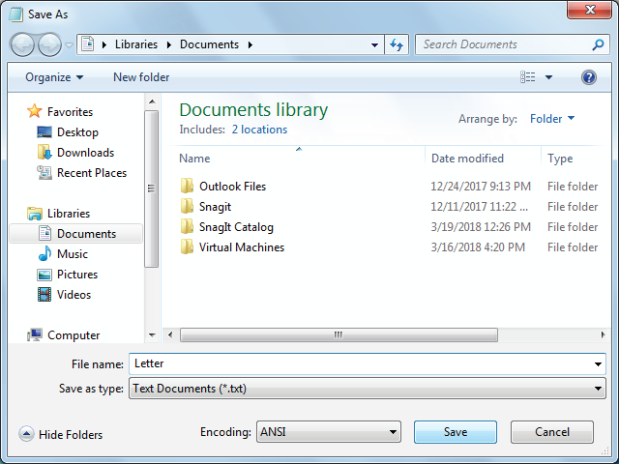
Creating and Saving a File
To save a notepad file, you need to specify the file name in the Save As dialog box, as shown in the given figure.
You can access this dialog box by clicking File → Save option.

Slide 40
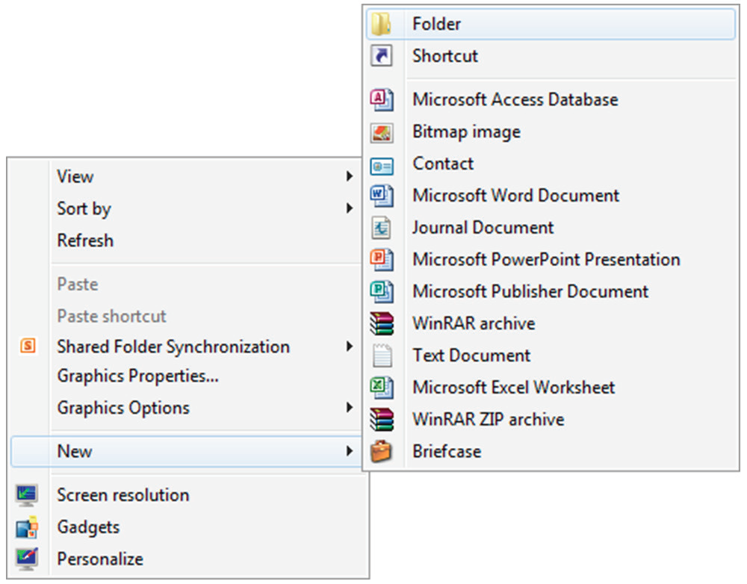


Creating a Folder
A folder acts as a container for files. We generally save those files in a folder that are related in some way to each other.
You can create a folder by right-clicking on the desktop and then select the New → Folder from the context menu, as shown in given figure.
The folder with a default name appears on your screen.
Now, enter a name for the folder and press the Enter key.
Creating a folder
Displaying a folder
With default name
Displaying a folder
with entered name

Slide 41
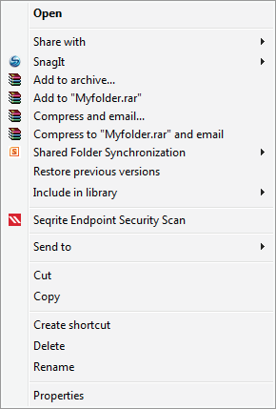
Renaming a File or a Folder
Renaming a file or a folder means changing the existing name of the file or folder.
You can rename a file or a folder by right-clicking the file or folder that you want to rename and then select the Rename option from the context menu.
Now, enter the name of the file or folder and press the Enter key.

Slide 42
Deleting Files and Folders
You can delete files or folders in your computer by right-click the file or folder you want to delete and then select the Delete option from the context menu. Now, select the Yes button in the Delete Folder dialog box.
After you delete a file or folder from your computer’s drive, it does not get permanently deleted from your computer.
The deleted file is moved in the Recycle Bin, which holds the deleted files or folders.
To remove a file permanently from your hard disk, you need to empty the Recycle Bin or individually delete a file from the Recycle Bin.
The Recycle Bin also allows you to restore the deleted file or folder.
To restore a file or folder from the Recycle Bin, you need to double-click the Recycle Bin icon on the desktop and then right-click the file or folder that you want to restore. Now, select the Restore option from the context menu.

Slide 43
Moving Files and Folders
Moving files and folders means changing the position of a file or folder from one location to another.
To copy/move your file or folder, you need to right-click the file or folder and then select the Copy or Cut option from the context menu.
  You need to select the Copy option from the context menu when you want to copy the file or folder or select the Cut option from the context menu when you want to move the file or folder.
  Now, navigate to the location where you want to store the file or folder.
  Right-click on any empty area in the navigated location and then select the Paste option from the context menu to paste the file or folder.
You can press the CTRL + X keys on the keyboard to cut a selected folder or file and press the CTRL + C keys to copy a selected folder or file.
Then, you can press the CTRL + V keys on the keyboard to paste the folder on the selected location

Slide 44
Session 7: Starting and Shutting Down a Computer
When you have finished working on your computer, you may want to shut it down.
In addition, if you wish to take a long break from working on the computer, but do not want to leave it vulnerable to unauthorized access, you may choose to log it off.
Sometimes, you may also restart the computer in case there is a problem that you are unable to fix or rectify (however, this is not always the solution of a problem).
To log off, restart, or shut down a computer, you need to first click the Start button and then place the mouse pointer on the arrow button next to the Shut down button on the bottom-right corner of the Start menu.
Now, a drop-down list appears with the Switch user, Log off, Lock, Restart and Sleep options.

Slide 45
Session 7: Starting and Shutting Down a Computer
Now, select the option to perform any of the following tasks:
  Select the Switch user option to log in with another account in the computer.
  Select the Log off option from the drop-down list to log off. You need to login again to work on the computer.
  Select the Lock option to lock the computer.
  Select the Restart option from the drop-down list to restart the computer. This causes the computer to reboot.
  Select the Sleep option to sleep the computer. In Sleep mode, computer takes very little power.
You can switch on your computer again by performing the following steps:
  Switch on the mains electricity button.
  Switch on the UPS power button.
  Switch on the CPU power button.
  Switch on the monitor power button.
The computer boots and displays the windows login screen.

Slide 46
Session 8: Internet
The Internet refers to a collection of an infinite number of computers spread across the world.
It is the largest computer network (a group of interconnected computers that can interact with one another) in the world.
The Internet is also called a network of networks as it encompasses many small, medium and large networks.
The Internet allows people to communicate with each other all over the world.

Slide 47
Applications of Internet
The applications of the Internet are as follows:
  Surfing and Searching the Internet: Surfing means moving from one website to the other using a Web browser. Searching the Internet means exploring various websites and Web pages on the Internet for the desired information. Some commonly used search engines are Google (www.google.com), Bing (www.bing.com) and Yahoo (www.search.yahoo.com).
  Email: Through email, you can communicate with anyone around the world by sending and receiving electronic messages within seconds.
  Chatting: Chat, as the name suggests, allows you to ‘talk’ real-time through messages.
  E-learning: Electronic learning (e-learning) is the mode of acquiring knowledge by means of the Internet and computer-based training programs.
  E-commerce: The concept of e-commerce is similar to commerce, which means transaction or exchange of goods and services.
  Entertainment: The Internet is also a great medium of entertainment. You can use it to play music, videos and games. For example, YouTube is one of the popular websites that provides videos online.

Slide 48
Web Browser
A Web browser is an application that is used to access or retrieve information or resources from the Internet.
This information is available in different formats, such as audio and video files, text and images.
Information resources on the Internet are identified by Uniform Resource Locator (URL), which is a unique address of each Web page.
Although a Web browser is specifically designed to access information from the Internet, it can also be used to access resources on the local Intranet or files in a file system.
There are two types of Web browsers:
  Text Web browsers: These Web browsers display only the text-based information. Lynx is an example of a text-based browser, which provides access to the Internet in the text-only mode.
  Graphical Web browsers: These Web browsers support both text and graphic information. The Internet Explorer, Mozilla Firefox and Google Chrome are examples of graphical Web browsers.

Slide 49
Websites and Web Pages
A Web page is a hypertext document that contains the information. It may contain hyperlinks that you can click to navigate to another section on the same Web page or a different Web page.
A website is a collection of the related Web pages linked to each other by hyperlinks. These Web pages are stored on a computer which is called a server.
A server is a computer that serves or attends to the requests of the other computers.
You can access a website from your computer by typing its address in the Address bar of the Web browser.
The following two terms are associated with a website:
  Home page: It refers to the main page of a website. Whenever you open or access a website, the home page of that website is displayed first on your screen.
  Web portal: It refers to a website that presents information from several sources. It also contains hyperlinks to many other websites. When you click any of these hyperlinks, you are redirected to the respective Web page. An example of a Web portal is www.yahoo.com.

Slide 50
Session 9: Email Applications
Email (Electronic mail) represents a mode of communication in which a user can send electronic messages to other users through the Internet.
The electronic message is delivered to the user in his or her email account. Email provides a convenient way to exchange digital messages across the Internet.
It is a mode that allows groups as well as individual users to share ideas, information, etc., with each other.
It is also a preferred way for the organizations to conduct communication within the organization and inform the customers about their new or existing products and the discounts they are offering.
You can send and receive email messages either by using an email server in a Web browser or email client application, such as Mozilla Thunderbird and Microsoft Outlook.

Slide 51
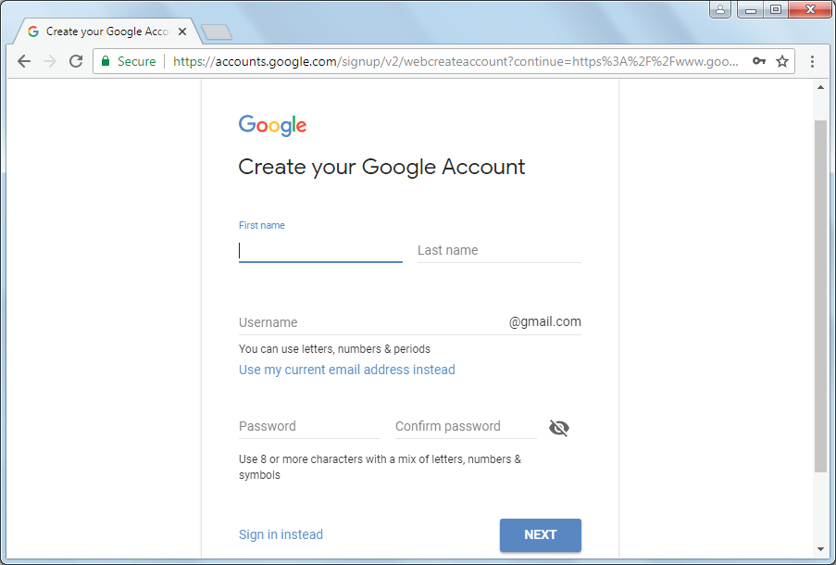
Email Accounts
In order to send an email, you need to specify the email address of the receiver.
The format of the email address is:
username@domainname
Before using the email service, you need to create an email account.
You can create a free Internet based email account on email servers, such as Gmail, Yahoo mail, Rediffmail, Hotmail, etc.
For example, we can log on to the website http://www.gmail.com and create a free account by filling up all the essential details in the required fields, such as Name, Username, Password, etc. as shown in the given figure

Slide 52
Sending and Receiving Email
After creating an email account, the next step is to log on to the account and check your email.
After reading an email message, you can send a reply mail or forward the message to other users.
Sending an email is a very simple process.
You can send an email message by using the following process:
  Click the COMPOSE button. The New Message pop-up window opens.
  Type the email addresses of the recipient(s) in the To text box, the subject of your email message in the Subject text box and your email message in the text area.
  Click the Send button to send your email to the desired recipient.
You can also attach files along with your email messages.

Slide 53
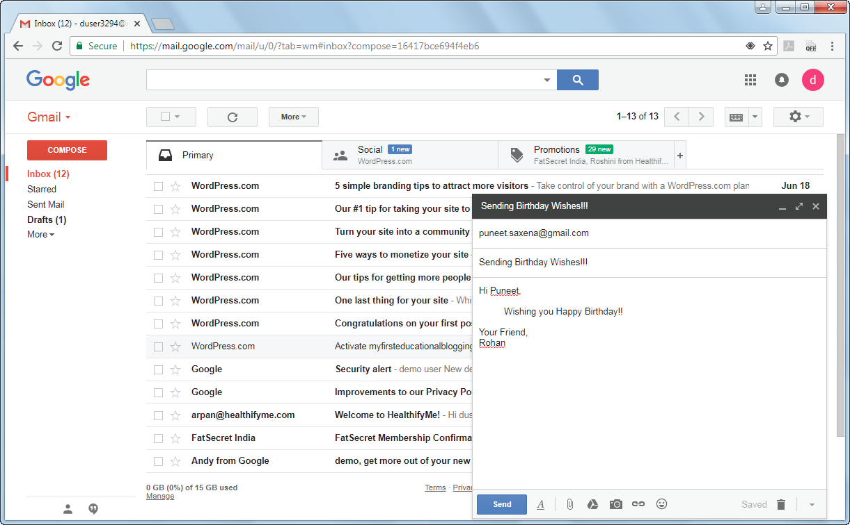
Sending and Receiving Email
The following figure shows the New Message pop-up window for sending an e-mail message:

Slide 54
Session 10: Introduction to Social Media
Social media are Internet-based technologies that facilitate the sharing of information, ideas, career interests and other forms of expression within virtual communities and networks.
There are different types of social media elements used for various purposes which are as follows:
  Social Network: It is a convenient way to get to know people whose interests, opinions and likes and dislikes are quite similar to yours. The Internet contains various social networking sites and you only need to register at these websites to be part of a social network. Examples of popular social networking websites are:
    Twitter: Twitter is an online news and social networking site, which allows its users to communicate through short messages called tweets.
    Facebook: Facebook is a commonly used free social networking website, which allows its users to create profiles, upload photos and videos and send messages.
  Media-Sharing: It lets you upload and share different media, such as videos, audios, or pictures. Examples of the popular media sharing websites are:
    YouTube: YouTube is a free video-sharing website, which allows its users to watch online videos. It also allows its users to upload and share their own created videos with others.
    Flickr: It is a website used for hosting images and videos.

Slide 55
Session 10: Introduction to Social Media
  Blogs: A blog can be defined as a website or part of a website containing the thoughts and ideas of a user. It is written in the form of a continuous commentary on any subject. Other users can read the blog as well as post their comments. Some examples of blogging websites are:
    Blogger: It is a blog-publishing website that enables a user to create and publish blogs on the Internet. The blogs created are hosted by Google and are accessed using a subdomain called blogspot.com.
    WordPress: It is a free and open-source content management system which also enables you to create and publish blogs.
  Social News: Social news is a platform that allows users to share different news items and also enable them to vote for these items. Some examples of social news aggregators are:
    Digg: It is a social news aggregator which aggregates trending issues, stories or news for Internet audience on the Internet.
    Reddit: It is also an American social news aggregator, Web content rating and discussion website.
  Social Networking Apps: The apps are small applications used generally on mobile phones for different purposes. There are plenty of social networking apps available online which can be downloaded easily on mobile phones. For example: WhatsApp

Slide 56
Session 11: Digital India
Digital India is a campaign launched by the Government of India with the aim of providing government services to citizens electronically by providing improved online infrastructure and Internet connection in the field of technology.
The concept behind initiating the Digital India programme is to transform India into a digitally enabled society and economy.
The vision of Digital India is segregated into three sub-visions:
  Infrastructure as utility to every citizen
    To avail high-speed Internet in all gram panchayats.
    To provide easy access to a CSC within their locality.
    To ensure safe and secure cyber space in the country. Etc.
  Governance and services on demand
    To transform government services digitally in order to make improvement in doing business.
    To avail government services in real time by using online or mobile platforms. Etc.
  Digital empowerment of citizens
    To enhance universal digital literacy.
    To make all digital resources accessible globally.
    To avail digital resources/services in various Indian languages. Etc

Slide 57
Thank You

