Slide 1
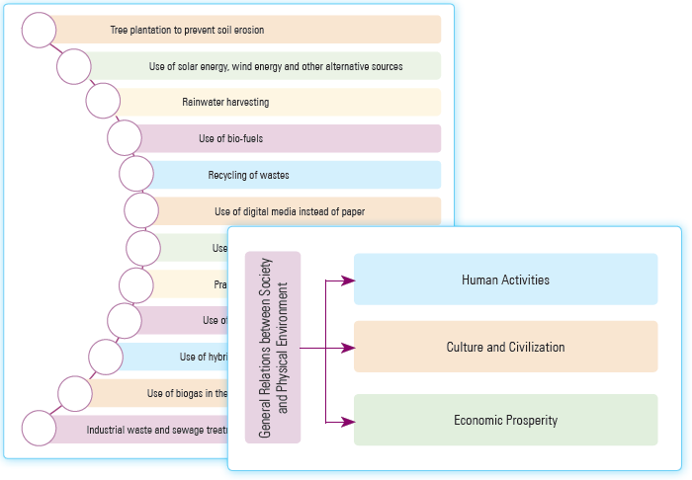
Green Skills-I
Unit 5

Slide 2
Learning Objectives
This Unit Covers:
Introduction to environment
Relationship between society and environment
Ecosystem
Natural resource conservation
Environmental protection and conservation
Green economy and its importance

Slide 3
Introduction
Green economy aims to provide a high quality of life by the efficient use of natural resources.
The factors behind adopting green economy are consumption of vast amount of non-renewable resources, non-availability of mineral and energy-resources frequently and growing number of poor people.
The steps towards developing green economy also make an impact on employment rate by offering green jobs which will define its significance in the future.
Green jobs can be created in different sectors, such as agriculture, industry, services or administration. These sectors may include the kinds of jobs that provide protection of ecosystems; reduce the consumption of energy, raw materials and water; and minimize waste and pollution. Now, to do such green jobs, some necessary green skills are required.
Green skills are the skills required to adapt the processes, services and products for climate change in compliance with the environment rules and regulations related to them.

Slide 4
Session 1: Introduction to Environment
Environment can be defined as everything that is around us.
It can be living and non-living organisms. It also includes physical, chemical and natural forces.
All living organisms live in their physical environment. They continuously interact with each other and adapt themselves to their physical environment.
Environment is the place, people, things and nature that surround any living organism.
It is our basic life support system which provides us the air, the water, the food and the land we need in our daily life.
An ecosystem can be represented as a natural unit that contains living organisms, such as animals, plants in order to work together with the physical environment.
These organisms fulfill their needs by interacting with the environment to which they belong. These needs include food, air, water, etc. The well-being of all the organisms is absolutely dependent on a healthy environment.

Slide 5
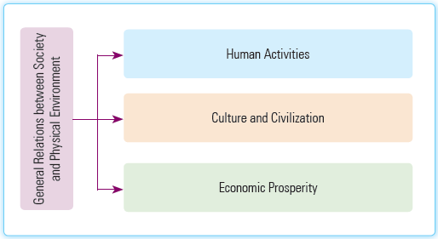
Session 2: Relationship between Society and Environment
Ecology is the combination of society people’s beliefs, cultures, activities and customs with respect to environment to fulfill their desires and for their own development.
Relationship between Society and Physical Environment is shown in following figure:

Slide 6
Session 2: Relationship between Society and Environment
The general relations between society and physical environment are as follows:
Human Activities: Human activities are deeply affected by extremely hot or cold weather. Moderate temperature is always considered as the best condition to evoke a human activity.
Culture and Civilization: Culture and civilization are greatly influenced by the surrounding environment. The great rivers like the Ganges, the Euphrates, the Nile, the Yangtzekiang, etc., already nurtured our earlier civilizations. The sea coasts were always a threshold for our social and cultural aspects along with acting as a natural barrier for our safety and security.
Economic Prosperity: The geographical condition of a country is deeply related with the economic prosperity of the region. Sufficient natural resources are necessary for the economic growth of a country. The production in a certain region depends upon the raw materials available in that region.

Slide 7
Session 2: Relationship between Society and Environment
The various physical features of the Earth affect the society in various ways, which are as follows:
Influence on population: The influence of plains on the population can be seen from the fact that a greater number of people live in the plains than elsewhere.
Influence on economic life: Major industries are found in towns on the plains because of higher density of population and availability of skilled labour.
Influence on transport and communication: In the plains, there is a wide network of roads and railway lines.
Influence on social life: The standard of living is higher in the plains as compared to that in the mountain as well as in the desert.
Influence on political life: Political life in the plains is dependent upon the availability of transport and communication.

Slide 8
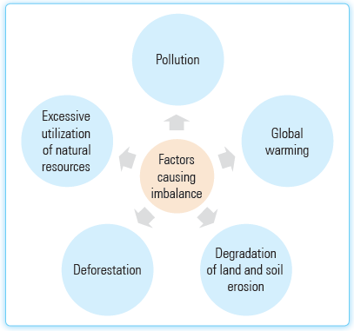
Session 3: Ecosystem
An ecosystem can be defined as the community of the living organisms with respect to their physical environment.
It can be of different sizes with hundreds of different living organisms, such as plants and animals in a fragile balance.
Factors responsible for causing imbalance in ecosystem are shown in the following figure:

Slide 9
Session 3: Ecosystem
The description of the factors causing imbalance in the ecosystem are as follows:
Pollution: It is one of the main reasons behind the ecosystem imbalance. It leads to an unhealthy environment that badly influences the life of the human beings. The main types of pollution are water pollution, air pollution, land pollution, noise pollution, etc.
Global warming: It continues to play a significant role to imbalance the ecosystem. It increases the temperature of the earth and also causes the climatic changes.
Degradation of land and soil erosion: It plays a vital role in the destruction of the ecosystem.
Deforestation: The forests are the one of the vital sources to make the ecosystem balance.
Excessive utilization of natural resources: The large extraction of the natural resources, such as soil, water, trees and fossil fuels for mining, logging and oil-drilling play a vital role in the destruction of the ecosystem.

Slide 10
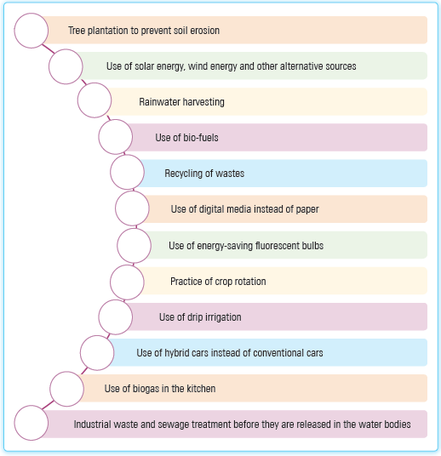
Session 4: Natural Resource Conservation
The protection, preservation, restoration and rational use of all the natural resources in the total environment are collectively called natural resource conservation.
It refers to the conservation of land, water, soil, plants and animals.
Failure in the conservation of the natural resources will put the future generation in tremendous hardships.
The given figure displays different ways that can be used to save and conserve the natural resources.

Slide 11
Session 5: Environmental Protection and Conservation
Environmental protection and conservation can be defined as the effort of securing the environment by the individual, government and non-government organizations for the profit of both the living organisms and the environment.
For the conservation of environment, various programmes like public awareness, conservation of forest, public campaign, environmental pollution, cultural heritage’s protection, etc., can be organized.
The major environmental issues are air pollution, water pollution, solid wastes, agrochemicals, radioactive wastes, greenhouse effect, global warming, ozone depletion in the stratosphere, etc.
Ramsar Convention, Stockholm Convention, Vienna Convention, Montreal Protocol, Rio Earth Summit, Kyoto Protocol, Nagoya Protocol and Paris Agreement are the major environmental conventions, conferences and summits held for the various environmental issues.

Slide 12
Session 6: Green Economy
Green economy can be defined as a sustainable economy that improves the human well-being and social equity and also supports the environment and ecological system.
It is about filling the gap between sustainable development and unbalanced resources, such as water, air, soil, etc.
Green economy helps in sustaining and advancing economic, environmental and social well-being.
Green economy is an economy that results in the growth and development of social well-being and that also aims at improving the environment on safety parameters.

Slide 13
Session 7: Importance of Green Economy
Development experts and the World Bank have learned that if we want to succeed in ending poverty, our growth should be inclusive and sustainable.
The most critical areas to achieve green economy are– responsible resource management, access to energy and good governance.
The vital roles played by the green economy are as follows:
It makes the quality of life better.
The environmental balances become harmonized.
The resource efficiency increases.
It causes new technological development.
New economic commodities generate, which may be in conformity with the environment.

Slide 14
Thank You

