Slide 1
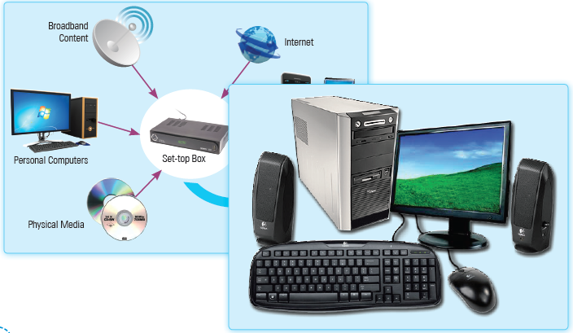
Fundamental of Computer
Unit 6

Slide 2
Learning Objectives
This Unit Covers:
Definition of a Computer
Functional Components of a Computer
Central Processing Unit
Applications of a Computer
Features of a Computer
Limitations of a Computer
Types of Computers
Convergence of Technologies

Slide 3
Introduction
Computers have established themselves as an indispensable part in various segments of human life, such as business, academics, defence strategy, budgeting, research, engineering, medicine and space exploration.
We depend on computers for everything—from paying electricity bills to withdrawing money from bank and so on.
Today, we can access information on any topic instantly from any place with the help of computers.
Technological convergence has almost revolutionized our daily life by changing the nature and the means we adopt to deal with communication, work and entertainment.

Slide 4
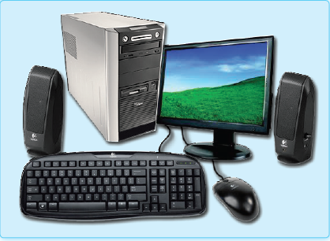
Session 1: Defining a Computer
A computer is an electronic device which is used to perform a variety of operations on the basis of a set of instructions called program.
A computer takes input from the user in the form of data or instructions.
On receiving the instructions from the user, the computer processes the data and generates some output and displays it to the user.
When the computer processes data, it becomes information.
The following figure shows a computer:

Slide 5
Data, Information, Hardware and Software
The description of data, information, hardware and software are as follows:
Understanding Data
Data denotes unprocessed raw facts and figures, such as a name or a number. A computer can accept data in various formats, such as text, numbers, audio, video and images.
Understanding Information
When a computer processes data and converts it into a form that is useful and meaningful to the user, it becomes information.
Understanding Hardware
Computer hardware refers to the physical parts of a computer. Physical parts refer to those parts or devices that you can touch, such as keyboard, mouse and monitor.
Understanding Software
Software can be defined as a set of programs necessary to carry out operations for a specified job. In simple words, software refers to the set of instructions that tell a computer how to perform a given task.

Slide 6
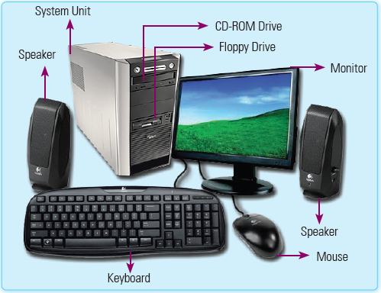
Session 2: Exploring Functional Components of a Computer
A computer consists of various components, such as system unit, monitor, mouse and keyboard.
The structure of a computer with its components is shown in the following figure:

Slide 7
Session 2: Exploring Functional Components of a Computer
The main components of a computer are explained as follows:
System Unit: Consists of various smaller components, such as Motherboard, Hard disk, Random Access Memory (RAM), Central Processing Unit (CPU) and Sound card.
Monitor: Displays the output of a computer. It is a television-like equipment which can be Cathode Ray Tube (CRT), Liquid Crystal Display (LCD) and Light Emitting Diode (LED).
Mouse: Refers to a pointing device that perfectly fits in your palm and allows you to perform certain activities on screen, such as clicking a button and placing the cursor at a specific location.
Keyboard: Refers to a device that contains keys to feed information into a computer.

Slide 8
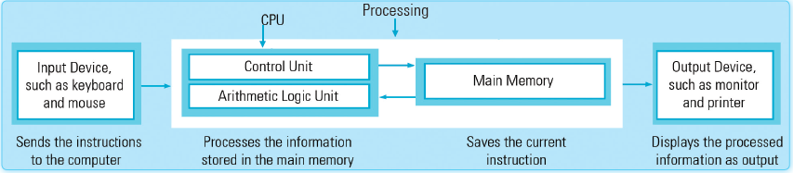
Session 3: Introducing Central Processing Unit
Central Processing Unit (CPU) is a physical device that controls computer operations.
It is known as the brain of a computer system as it controls all the operations of a computer on the basis of the instructions specified by a user.
It looks like a small chip and is placed on the motherboard.
The following figure illustrates the basic functionality of a CPU:

Slide 9
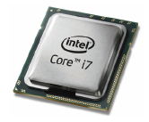
Session 3: Introducing Central Processing Unit
The speed of CPU is measured in Megahertz (MHz) or Gigahertz (GHz).
The following figure shows a CPU:
Two typical components of the CPU are:
The Arithmetic Logic Unit (ALU): It performs arithmetic and logical operations.
The Control Unit: It extracts instructions from the computer memory, decodes and executes instructions and takes help of ALU if required.

Slide 10
Arithmetic Logic Unit
The ALU is a digital circuit that is used to execute arithmetic and logical operations in a computer system.
The arithmetic operations include addition (+), subtraction (−), multiplication (*) and division (/).
The logical operations include greater than (>), less than (<), greater than equal to (≥), less than equal to (≤), equal to (=) and not equal to (≠).
Therefore, whenever a computer performs arithmetic operations or makes a comparison, CPU activates the ALU.
The result of any arithmetic and logical operation is stored in the computer memory.

Slide 11
Control Unit
The control unit of the CPU supervises and monitors the functions performed by the entire computer system.
A special program called supervisor is responsible for controlling the system operations.
The instructions in each program are transferred, one at a time, to the control unit.
The circuitry of the control unit, in turn, interprets and executes the instructions.
When you provide any input, the control unit determines the type of the instruction and according to the nature of instruction, the control unit guides the ALU or input/output devices.

Slide 12
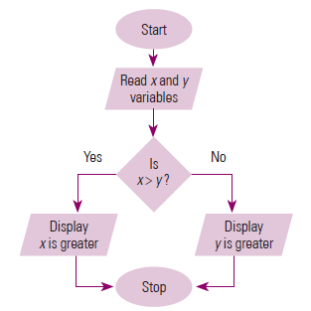
Control Unit
The flowchart in the following figure depicts the functioning of the Control Unit:

Slide 13
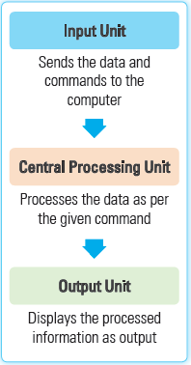
Session 4: Working of a Computer
A computer follows the input-process-output model.
Input refers to the process of feeding data or instructions in a computer.
Process refers to the work done by the computer with the help of hardware and software.
Output refers to the result that is obtained when the computer processes the input.
The figure shows the basic functioning of a computer.

Slide 14
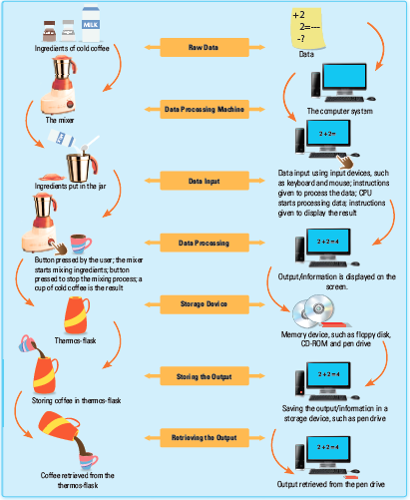
Session 4: Working of a Computer
Following figure shows a comparison between a mixer and a computer.

Slide 15
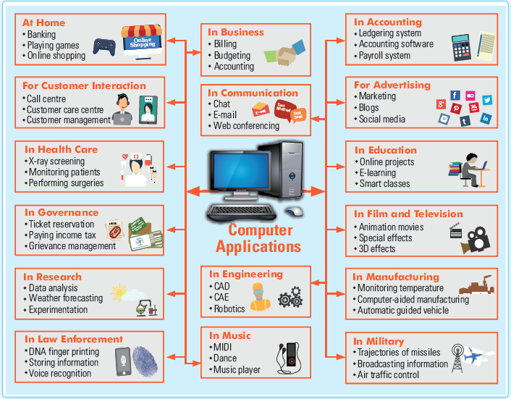
Session 5: Applications of a Computer
Applications of computers in various fields are shown in given figure:

Slide 16
Session 6: Features and Limitations of a Computer
Some features of a computer are as follows:
Speed: Computers perform their functions at a greater speed and have the capability of processing even the most complex computations in a matter of seconds.
Accuracy: Computers have the ability to provide accurate results as they perform computations with utmost accuracy.
Storage capacity: The storage capacity of a computer defines how much information can be stored in it.
Reliability: The electronic components in modern computers make them more reliable as they rarely break or fail.
Consistency: A computer generates consistent results if provided with the same input and processes.
Versatility: Computers are able to perform different tasks in a variety of domains, such as education, entertainment, health care, accounting and hospitality.

Slide 17
Limitations of a Computer
Some limitations of a computer are as follows:
No Power to Make Decisions: Computers are unable to take decisions on their own; instead, they depend upon the input being provided by humans.
No IQ: Computers are machines that do not have self-intelligence; instead, they need to be informed from time to time regarding the tasks to be performed.
No Heuristics: Computers are not able to learn from their past experiences. It implies that when a computer commits an error once, it would commit the same error again in a similar fashion.

Slide 18
Session 7: Types of Computers
Types of Computers
Desktop Computer
Personal Digital Assistant
Laptop
Tablet
Smartphone
Mainframe Computer
Supercomputer
Self-destructing Computer
Workstation
Embedded Computer

Slide 19
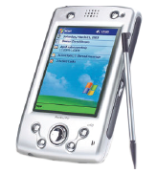
Session 7: Types of Computers
Depending upon their accessibility, portability and user-friendliness, computing devices can be classified into many categories.
Some of the commonly used computing devices are as follows:
Desktop Computer: A desktop computer is primarily used in an office or home. It can be used independently of any other computer; therefore, this computer is also called Personal Computer (PC).
Hand-held Computer or Personal Digital Assistant: A Personal Digital Assistant (PDA) is a lightweight, hand-held computer designed to be used as a personal organizer. A typical PDA does not contain a conventional keyboard; instead, it relies on recognition of handwritten input through the use of Stylus (a special type of pen used to write text and select options on the LCD screen).
Desktop Computer
Personal Digital Assistant

Slide 20
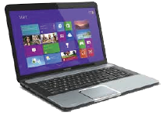

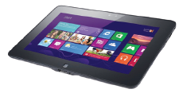
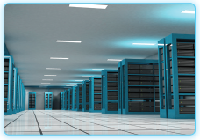
Session 7: Types of Computers
Laptop: A laptop is a portable computer that is integrated with a display screen, keyboard, trackball, processor and memory. The entire machinery of a laptop runs on a rechargeable battery.
Tablet: A tablet is a kind of microcomputer which offers a host of new features to the IT-savvy world.
Smartphone: A smartphone is basically a mobile phone that provides additional features to perform day-to-day tasks.
Mainframe Computer: Mainframes are designed for multitasking and can be used by many users simultaneously. Mainframes can approximately provide up to 12 parallel 650 MHz processors, 32 GB primary memory and several terabytes of disk storage. The processing speed of a mainframe computer is around 80 to 550 Mips.
Laptop
Smartphone
Tablet
Mainframe Computer

Slide 21
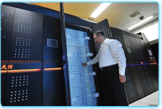
Session 7: Types of Computers
Supercomputer: A supercomputer consists of a large number of processors and occupies a huge amount of space. Supercomputers can process trillions of operations per second (teraflops). A supercomputer has a large number of CPUs and provides very fast and high level of computing. For example, Tianhe-2 supercomputer of China consists of 16000 computer nodes and can process 33.86 petaflops. The following figure shows a supercomputer:
Self-Destructing Computer: In an effort to limit the amount of data that computer thieves can retrieve from stolen computers, a device is being developed that can locate and, if necessary, destroy a computer’s hard drive. Cyber Group Network (CGN) Corp. developed the first self-destructing computer. The name of the device is C-4 chip.

Slide 22
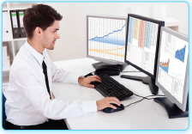
Session 7: Types of Computers
Workstation: The processing of workstations is similar to that of personal computers; however, workstations have greater memory and more extensive mathematical abilities. Workstations can be connected to other workstations or personal computers to exchange data. Generally, these types of computers are used where a high level of computational abilities is required, such as in scientific, industrial and business environments. A workstation shows in the following figure:
Embedded Computer: You must have noticed the circuits of various appliances, such as televisions and washing machines. In these appliances, there is an inbuilt preprogrammed computer that performs some specific tasks. Consider the example of an automated washing machine in which the process of washing clothes starts automatically and continues for a specified time period.

Slide 23
Session 8: Convergence of Technologies
Technological convergence denotes merging of two or more existing technologies to invent a completely new technology with multiple benefits.
The term technological convergence gained popularity in the 20th century with the emergence of computers, Internet and mobile phones.
Let’s try to understand this concept with the help of an example.
A smartphone combines formerly-separated technologies, such as voice, data and video and make them operate on a single platform.
In a smartphone, these technologies work as a shared resource and interrelate with each other.
This eliminates the need of using multiple devices; thus, instead of carrying separate devices, such as a mobile phone, camera, pager and digital organizer, you can now use a smartphone that assembles all these technologies.

Slide 24
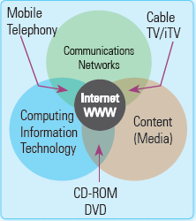
The 3Cs of Technological Convergence
The merger of computing, content and communications into a single system is referred to as the 3Cs of technological convergence.
The 3Cs of technological convergence are explained as follows:
Computing: It refers to the design and construction of computers to perform various types of tasks. An example of computing technology is the development of a software program that allows people to work at home on the tasks assigned to them from their job locations.
Content: It refers to any type of meaningful data or information that is expressed through some medium, such as speech, writing or images. Content can be transmitted and shared through diverse media, such as the Internet, television, books, magazines and CDs.
Communications: It refers to the interaction of multiple computers over a network to share data, information and other resources. Some examples of communication technology include mobile communication and Internet-based communication technologies.

Slide 25
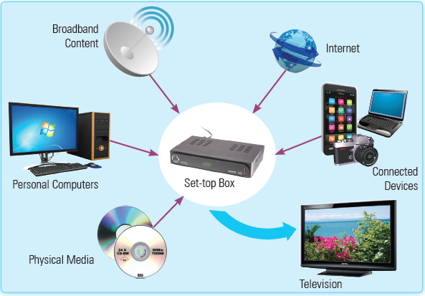
Types of Technological Convergence
Depending on the technologies involved, convergence can be of the following types:
Digital Convergence: It refers to the merger of the Internet, telecommunication and leisure industries. Digital convergence enables you to convert various types of content, such as text, voice, video, graphics, pictures, etc. into digital form, view multimedia content and share it through different types of devices. The following figure shows a digital convergence:

Slide 26
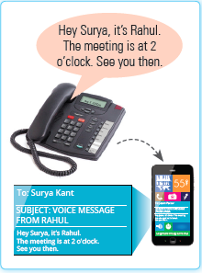
Types of Technological Convergence
Messaging Convergence: It refers to the integration of text and voice messages. For example, text SMS, voice SMS, Interactive Voice Response (IVR), Multimedia Messaging Service (MMS), etc. Following figure shows a messaging convergence:
Media Convergence: Media convergence has greatly impacted our daily life and even transformed the way we perform our routine activities. For example, earlier, we used a video player to play videos, a tape recorder to play music and an FM tuner to play radio.
Content Convergence: It refers to the integration of content from various sources on the Internet. For example, various content media such as advertising billboards, magazines, newspapers, radio stations and television provide content on specific Internet websites.

Slide 27
Thank You

