Slide 1

Progress Report on Digital India

Slide 2
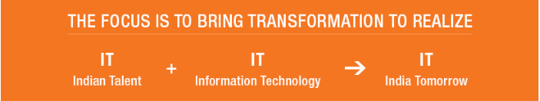
Digital India Programme
The Digital India programme is a flagship programme of the Government of India .
The vision of Digital India programme is to transform India into a digitally empowered society and knowledge economy.

Slide 3
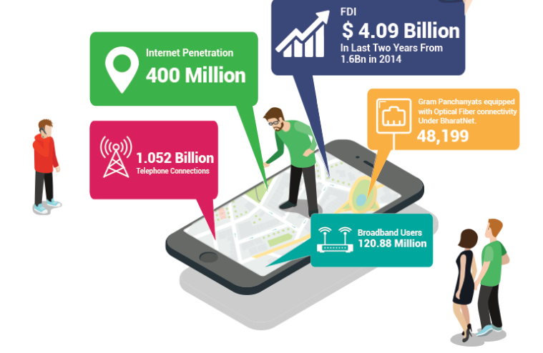
PROGRESS OVERVIEW
Following figure shows the progress overview of digital India program:

Slide 4
Key Achievement
Key Achievement 2017 of Digital India program according to MeitY are as follows:
Investment in Electronic Manufacturing grew by 27% in 2017.
In 2017 total investment reached 1.57 lakh crore while 2014 it was only 11,000 crore.
Registered over 300% growth in digital transaction in last one year.
Aadhaar, the unique identity, covers over 99 percent adult residents of India.
Over 197 cr. Placed in DigiLocker.
60% rise on the production of mobile phones
In 2017 it was reached 17.5 crore units while in 2014-15 it was only 6 crore units.

Slide 5
The Mobile Phone Revolution
In 2017, India has 121 Crore Mobile Phone users as compared to 103 crore in 2016.
Smartphone Users: 40 crore in 2017
Internet Users: 50 crore in 2017
Growth in Mobile Phone Manufacturing:
Jump of 60% in terms of units made.
Manufacturing of mobile phones has reached 17.5 Crore units in 2016-17 from 11 crore in 2015-16.
105 mobile/ ancillary manufacturing units.
Created 4 lakh direct and indirect jobs since 2014 of which 2.4 lakh added in 2017.

Slide 6
Investment in Electronic Manufacturing
Following table shows the Investment in Electronic Manufacturing sector:
Investment in Electronic Manufacturing | 2016 | 2017 | % Growth
MSIPS: Number of proposals | 217 | 242 | 11.5%
MSIPS: Investment involved | 1.23 lakh crore | 1.57 Lakh crore | 27%

Slide 7
Growth in Digital Payments
There has been a significant growth in various forms of digital payment due to initiatives taken by the Government in the aftermath of demonetization.
The trend can be explained through the following table:
Sl No. | Mode | 8th Nov 2016 | 18th Oct, 2017
1 | BHIM/ UPI | 4000/ day | 25.6 lakh/ day
2 | Mobile Wallets | 22 lakh/ day | 88.43 lakh/ day
3 | Debit Cards | 40 lakh/ day | 82 lakh/ day

Slide 8
Aadhaar
With an objective to empower residents of India with a unique identity and a digital platform to authenticate anytime, anywhere, Aadhaar today is the world’s largest biometrics based digital identity system.
Total number of Aadhaar account holders reached 119 Crore in 2017 compared to 104 Crore in 2016.
Aadhaar is being used as a digital platform to enhance governance.

Slide 9
Aadhaar
Following table shows the Progress of Aadhaar :
Sl. No. | Items | Status as per 2016 | Status as per 2017
1 | Total Number of Aadhaar Generated | 104 crore | 119 Crore
2 | Percentage of Adult Population on Aadhaar | 86.6% | 99.9%
3 | Total Mobile SIMs issued using Aadhaar eKYC | Implemented from September, 2016. | 32 Crore

Slide 10
Jeevan Pramaan
It is an Aadhaar based platform for biometric authentication of the pensioners and senior citizens.
Since its launch on 10 November 2014, over 150.15 lakh pensioners have registered on the portal till date, which was 16.54 lakh in 2016.

Slide 11
Digital Locker System (DigiLocker)
DigiLocker, launched in July 2016, serves as a platform to enable citizens to securely store and share their documents with service providers electronically after giving due permission.
197 crore document have been placed in DigiLocker enabling access to over 88 lakh users.
For the first time both CBSE 10th Class results and NEET Results were also sent digitally into Digital Locker.

Slide 12
Direct Benefit Transfers (DBT) through Aadhaar Payment Bridge (APB)
A total of Rs. 2.43 Lakh Crore have been disbursed through Aadhaar based DBT to beneficiaries of 394 government schemes which have led to saving of Rs. 57,000 Crore in the last 3 years by removing fictitious claimants.
Through this process a total of 2.33 Cr. bogusration cards and 3 crore fake LPG connections were identified.

Slide 13
e-Taal (Electronic Transaction Aggregation & Analysis Layer)
There has been a stupendous growth in e-Transactions in various e-Governance services.
Today, e-Taal registers 4.5 crores transactions per day which grew from 2.07 crore in 2016 thereby integrating over 3506 e-Services.

Slide 14
Common Services Centres (CSCs)
CSCs are the world’s largest digital service delivery network.
These information and communication technology enabled kiosks with broadband connectivity has been providing various governments, private and social services at the doorsteps of citizen.
Today, around 2.7 lakh CSCs are active and offering digital services like Aadhaar enrolment, Ticket booking, of utilities and other eGovernance services to citizens from 1.68 Lakh Gram Panchayets, which was only 2.29 Lakh 2016.

Slide 15
MyGov
This is a citizen-centric digital collaboration platform that empowers people to connect with the Government & contribute towards good governance.
Started on July 26th 2014 and with a modest 8.74 lakh users in the first year, today MyGov has over 50 lakh active users under 64 groups who contribute their ideas through 756 discussion groups and participate through 701 earmarked tasks, that has grown from 36 lakh active users in 2016.

Slide 16
Other noteworthy achievements
India BPO Promotion Scheme: 18,160 seats of BPO already allocated. Another 13822 sect allocation nearing finalisation
Jan Dhan Accounts: 30 Crore
Jan Suraksha Schemes Registrations: 15 Crore
MUDRA: 9 lakh people got Rs. 4 lakh Crores of loan
Soil Health Card: 9.5 Crore cards made
eNAM: 50 lakh registered farmers; 455 Agri Markets linked
National Scholarship Portal: 1.4 Crore students registered
GeM: 4600 byers, 14,512 sellers registered

Slide 17
Thank You

