Slide 1
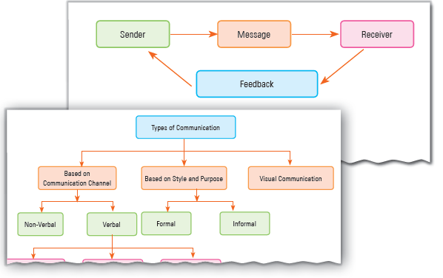
Communication Skills-II
Unit 1

Slide 2
Learning Objectives
This Unit Covers:
Communication and Its Types
Communication Cycle
7Cs of Effective Communication
Feedback and Its Importance
Types of Feedback
Barriers to Effective Communication
Types of Communication Barriers
Measures to Overcome Communication Barriers
Importance of Writing Skills

Slide 3
Introduction
Communication refers to the process of exchanging thoughts, facts, and ideas between two or more individuals by means of verbal and non-verbal languages.
The process of communication includes encoding, channeling and providing information by a sender to a receiver.
The process of speaking involves encoding the message and expressing it verbally or non-verbally.
Listening is a process that involves decoding and understanding the message.

Slide 4
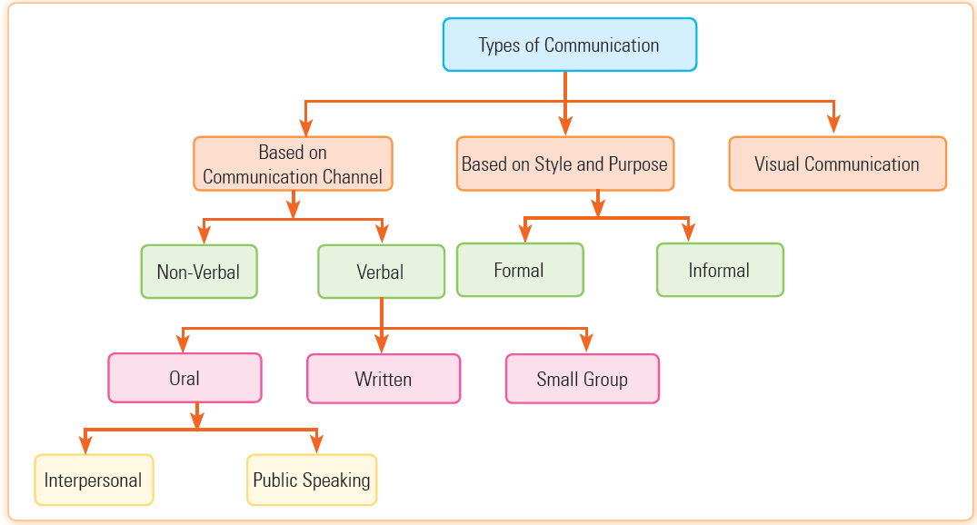
Session 1: Communication and Its Types
Communication involves three basic components: a sender, a recipient and a message that the sender wants to send to the recipient.
The process of communication includes encoding, channeling and imparting information by a sender to a receiver with the help of a medium.
There are various ways through which communication is possible as shown in Figure.

Slide 5
Based on Communication Channel
Non-verbal: Non-verbal communication involves various signs or facial expressions used to convey a message. Some signs of non-verbal communication are:
Kinesics, a kind of body movement or facial expression
Personal appearance of the person
Physical environment
Gestures, expressions, posture
Eye-contact and paralanguage
Verbal: Verbal communication takes place with the help of sounds, words and language. This kind of communication involves speaking. Speaking is an effective way to communicate. Spoken communication can be classified in the following ways:

Slide 6
Based on Communication Channel
Oral: It is the process of conveying messages through the word of mouth. It canbe of the following two types:
Interpersonal Communication: It may be defined as the communication between two persons at a personal level.
Public Speaking: It is the process in which a single person addresses an audience.
Written: It is the process of sending messages through letters, newsletters, mails, etc.
Small Group: In this type of communication, two or more people are involved in the conversation, for example, office meetings, group discussion, etc.

Slide 7
Based on Style and Purpose
Formal Communication: In this type of communication, the communication channel is already defined. All the corporate communications are examples of formal communication. They can be both oral and written.
Informal Communication: In this type of communication, the communication channel is not predefined, which implies that the communication stretches in all directions. It is also called the grapevine communication.
Visual communication: It is a method of communication where ideas and information can be read or seen by the recipient. This type of communication can be viewed through the means of visual aid. The sign of visual communication are warning sign, no parking zone and no entry, etc.

Slide 8
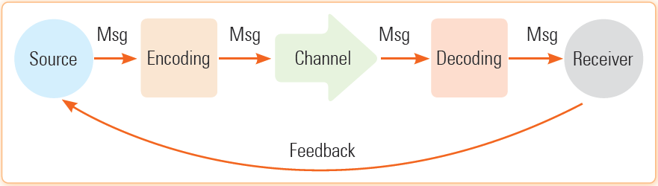
Session 2: Communication Cycle
The communication cycle is the entire process of communication in which a message is originated and sent to the right person through a proper medium.
The person who receives the message interprets the message and responds to it.
The response or feedback received from the recipient opens the way to further communication between both the parties.
The communication cycle consists of seven basic elements that are sender, message, encoding, communication channel, decoding, receiver, and feedback, as shown in Figure:

Slide 9
Session 2: Communication Cycle
The description of these elements of the communication cycle in as follows:
Sender: It refers to a party or agent who sends the intended message to another party or agent. Sender is also referred to as a source in the process of communication.
Ideas or Message: It refers to the subject matter that the sender wishes to convey to the receiver. It may be an opinion, attitude, feeling, view, order, or suggestion.
Encoding: It refers to a process that puts the thoughts in a framework of symbols or words.
Communication Channel: It refers to the channel responsible for the delivery of the message. For example, post office, Internet, and radio.
Receiver: It refers to a party or agent who receives the sent message. The receiver is also called the audience or destination.

Slide 10
Session 2: Communication Cycle
Decoding: It refers to the process of deciphering the received message and understanding its intended meaning.
Feedback: It refers to the response of the receiver to the message of the sender. This part of the communication cycle establishes a two-way communication between the receiver and the sender. It can be an acknowledgment of receiving the message or reply to the message.
An effective communication requires all the aforementioned elements.
In the communication process, the sender should know the types of audience and their desirable responses. It is very important for the sender to compose the message properly so that the receiver can easily understand the intent of the message.

Slide 11
Session 2: Communication Cycle
In encoding, the type of the target audience should also be kept in mind. The audience should be capable and intelligent enough to understand the intended message.
The message should be free from ambiguities to facilitate a clear and discrete interpretation. There should be no distortion in the message while it is passed through a medium (through which the message passes).
The medium/media should be efficient enough to minimize the distortion of the message and promote the passage of the message clearly.
The sender should also have a feedback channel to facilitate the following:
Acknowledging the delivery of the message
Getting receiver’s response about the message

Slide 12
Session 3: 7Cs of Effective Communication
Communication can be called effective only if the receiver interprets the message as desired by the sender.
The 7Cs of effective communication are as follows:
Clarity: It implies that the communication should be clear enough so that the receiver can easily understand the message of the sender. Conveying clear information enables the receiver to read the mind of the sender. One should keep in mind the following points to convey a clear message:
Objective of the message to be conveyed
Length, simplicity, and relevancy of sentences
Suitable medium to convey the message
The targeted receiver (top level, medium level, or lower level of the organizational hierarchy)

Slide 13
Session 3: 7Cs of Effective Communication
Completeness: It implies that communication should contain all the information necessary to get the desirable response from the sender. On the other hand, the sender should answer all the questions asked by the receiver and pay attention to all minute details. This leads to effective communication, which results in the accomplishment of predefined goals. If the communication is not complete, it can result into misinterpretation of information by the sender or receiver. The following points should be taken into consideration, while checking for the completeness of communication:
Answering all asked questions
Conveying extra details when desirable; however, the details should be relevant
Checking for five Ws, that are what, when, where, why, who

Slide 14
Session 3: 7Cs of Effective Communication
Conciseness: It implies that the message should be free from superfluous details, which helps in saving the time of both, the sender and the receiver. Moreover, to make the communication effective, one should avoid wordy expressions and repetitions. However, conciseness should not compromise the completeness of the message.
Consideration: It requires preparing the message keeping the recipient in mind. A sender, while sending the message should take into consideration the views, thoughts, background, mindset, and education level of the receiver and vice versa. A considerate message should have the following features:
Laying emphasis on “you” approach, that is keeping the receiver in the sender’s place.
Showing interest in the sender while sending message to her/him. This helps in receiving the positive response from the sender.

Slide 15
Session 3: 7Cs of Effective Communication
Correctness: It implies that the message should state accurate facts and figures. Moreover, one should use the right level of language. In addition, the message should be free from grammar, spelling, and punctuation errors.
Concreteness: It implies that the message should be specific and to the point. The details provided in the message should be definite and vivid. One should avoid using vague and obscure statements in the message.
Courtesy: It constitutes one of the important elements of an effective business communication. One should use polite words in the message and should be appreciative, thoughtful, and tactful, while receiving or sending a message.

Slide 16
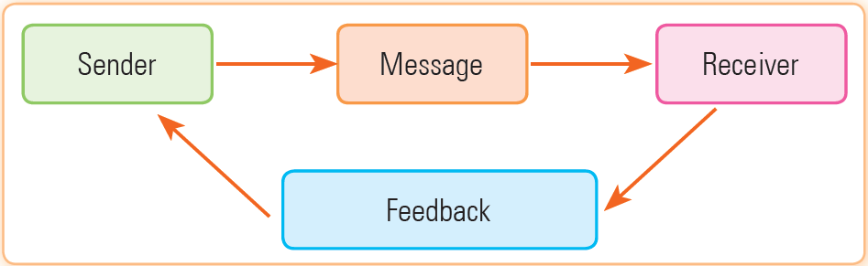
Session 4: Feedback and Its Importance
Communication is incomplete without feedback. In case of communication cycle with feedback, the receiver does not only receive the message, he/she can also respond to the sender.
The response given by the recipient to the sender is called feedback.
The communication cycle with feedback is shown in Figure.
Feedback is the response from the receiver’s side. If the receiver is not able to understand the message, then depending upon the feedback, the sender can refine the message.

Slide 17
Session 4: Feedback and Its Importance
Feedback is of two types, written feedback and oral feedback.
Written Feedback: After the completion of a specific task, written feedback is provided.
Oral Feedback: Such kind of feedback is given when a task is being performed. Oral feedback is an informal type of feedback.
There are two types of feedback: positive feedback and negative feedback. The description of these types of feedback is as follows:
Positive Feedback: It refers to the feedback in which an individual is told about the areas where he/she is doing well and is praised for the good performance.
Negative Feedback: It refers to the feedback wherein an individual is told about the areas where he/she requires improvement.

Slide 18
Session 4: Feedback and Its Importance
There are two ways to give the feedback to an individual or a group, which are as follows:
Specific Feedback: It refers to the feedback in which a detailed information is given to the individuals about what they have done and what not.
Non-specific Feedback: It refers to the feedback in which a general statement is passed to the individuals related to their work, such as Great Job, It’s Good.

Slide 19
Session 5: Barriers to Effective Communication
Communication barriers may cause misunderstanding or misinterpretation of the message.
A communication barrier is anything that refrains us from understanding the message sent by someone.
There are various factors which need to be avoided to facilitate effective communication such as stereotyping and halo effect.
Various types of communication barriers are explained as follows:
Physical Barriers: These are the barriers that occur due to environmental and natural factors and hinder the flow of messages.
Language Barriers: The difference in the language, accent, and dialect of the communicating parties as well as the use of slangs and jargons can make messages ambiguous and unclear.

Slide 20
Session 5: Barriers to Effective Communication
Gender Barriers: Gender barriers are any misunderstanding or confusion in the intended message caused by male and female differences.
Attitudinal Barrier: The behavior or perception of a person that may prevent him/her from conveying the message properly is called attitudinal barrier.
Perceptual Barrier: Different people have different views. Different views may lead to misunderstanding. This may lead to miscommunication.
Cultural Barrier: Social, religious, and ethical differences may lead to misunderstanding and misinterpretation of the messages.
Emotional Barrier: Due to anger, fear and other kind of emotions, it becomes difficult to understand what someone wants to convey.

Slide 21
Session 6: Measures to Overcome Communication Barriers
Some measures to overcome communication barriers are explained as follows:
Try to Assess the Needs of Receiver: The speaker or sender of the message should always ask for the feedback from the receiver’s end.
Hone Your Active Listening Skills: Listening plays a major role in making any communication/conversation successful.
Soften Your Tone and Language: It is necessary for the boss of an organization to soften down his/her tone while talking to the employees as his/her every move is watched by others.
Encourage Feedback: It is the responsibility of the sender to convey the message successfully to the receiver. To know whether this is happening or not, one should take feedback from the receiver frequently.

Slide 22
Session 7: Importance of Writing Skills
Writing skill is an important and essential part of communication skills.
Good writing skills makes it easy to communicate your message to a large number of audience.
The writing should be such that it is easy for the receiver to understand.
The language used for writing should be chosen according to the audience.
Some common elements of the English language are:
Phrase: A group of words in English is called a phrase. There are different types of phrases such as noun, verb and adjective phrase.
Sentences: A sentence may be defined as an arrangement of words such that one can express his/her ideas clearly in writing. There are different types of sentences such as simple, compound, complex, declarative, imperative, interrogative and exclamatory.

Slide 23
Session 7: Importance of Writing Skills
Parts of speech may be defined as the categories of words based on their grammatical properties. Various types of parts of speech are as follows:
Noun: It is the name of a person, place, animal, thing or an idea.
Pronoun: It is a word that can replace a noun.
Adjective: It is used with a noun to define its quality, quantity, characteristics and nature.
Verb: It tells about the action taking place in a sentence.
Adverb: It changes the meaning of a verb, adjective or another adverb in a sentence.
Articles are of two types:
Definite Articles: Such articles are used to specify a particular thing. For example, The Sun.
Indefinite Articles: Such articles are used to specify a non-particular noun. For example, He wants to buy a car.

Slide 24
Session 7: Importance of Writing Skills
A paragraph may be defined as a set of sentences that are focused on a particular topic. The elements of a paragraph may be defined as:
Order: The order may be defined as the way sentences are arranged in a paragraph. The sentences may be arranged based upon their importance.
Unity: As we move to a new line in a paragraph, it must define the topic in more detail. The focus should be on detailing of one topic. This is called paragraph unity.
Coherence: Every sentence in a paragraph should be logically connected to the next line in the paragraph.
Completeness: A paragraph is said to be complete if it provides sufficient information about a topic.

Slide 25
Session 7: Importance of Writing Skills
Punctuation marks are symbols that help to separate parts of a sentence to make it meaningful. Some punctuation marks are as follows:
Full Stop (.): It is used to indicate the end of a sentence.
Comma (,): It is used to indicate a pause in a sentence.
Question Mark (?): It is used at the end of a sentence to ask a question.
Exclamation Mark (!): It is used at the end of a sentence or word to indicate surprise, anger or shock.
Apostrophe (‘): It is used at the end of the word, followed by s. It shows that something belongs to someone, for example, Harry’s notebook.
In active voice, the subject of the sentence acts on its verb, whereas in passive voice, the subject of the sentence receives the action of the verb.
Capitalization is process of writing the first letter of a word in capital letter (uppercase) and the remaining letters in lowercase.

Slide 26
Thank You

