Slide 1
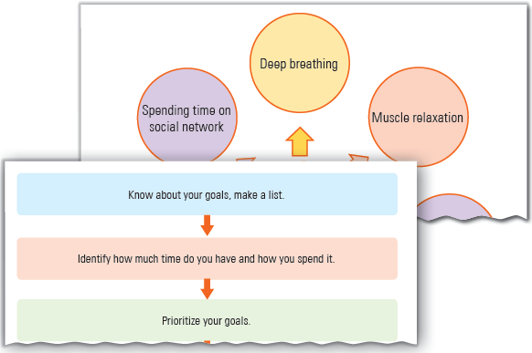
Self-Management Skills – II
Unit 2

Slide 2
Learning Objectives
This Unit Covers:
Stress Management
Self-awareness
Self-motivation
Self-regulation
Self-analysis/Knowing Yourself
Time Management
Goal Setting

Slide 3
Introduction
Self-management is defined as the application of skills and strategies that help an individual throughout his/her life to achieve goals and objectives and become more productive.
Self-management includes decision-making, managing time, setting goals and making plans and time table.
Self-management covers the abilities of an individual to manage sentiments, feelings and tough situations effectively.
Self-management skills are those skills that help individuals become more productive in their personal as well as professional lives.
Some self-management skills are stress management, self-awareness, self-motivation, self-regulation, and self-analysis.
Self-management skills help to create and maintain an environment in which people work to achieve predefined goals by making an optimum utilization of all the available resources.

Slide 4
Session 1: Stress Management
Stress is a general term that represents various kinds of pressures people experience in life.
Stress can be understood as a reaction that people have toward excessive pressures triggered by the demand placed upon them.
Stress arises due to inside and outside forces of an environment.
Outside forces from the environment that may cause stress include relationships, jobs, difficulties, expectations, etc.
Internal forces are emotions, thoughts, mental abilities, etc. Sometimes, stress levels become uncontrollable, which may result in chronic anxiety that can lead to heart diseases, high blood pressure, etc.
Stress management is a skill of controlling and managing an individual’s level of stress and making the activities of life more organized.
There are two types of stress one is positive stress and the other one is negative stress.

Slide 5
Session 1: Stress Management
Good stress or positive stress (also called eustress) helps you in getting through a situation where an extra push is required. For instance, the anxiety and nervousness that you feel before giving a presentation.
Bad stress or negative stress (also called distress) can cause various mental and physical problems, if left ignored, untreated, or unmanaged.
As the perception and reactions to various situations are different from person to person, the stress level experienced by different people is also different.
Stress can be handled by:
  Recognising you are in stress
  Identifying the source of stress
  Applying the stress management techniques to reduce stress

Slide 6
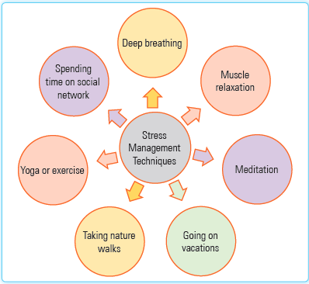
Stress Management Techniques
Stress management techniques are used to control and reduce stress.
In an organization, an employer must develop positive stress at workplace. Negative stress must be avoided.
This can be done by providing an opportunity to workers to participate in decision-making activities or by offering incentives and promotion benefits to employees
Some techniques which may help an individual to reduce the level of stress is shown in Figure.

Slide 7
Stress Management Techniques
These techniques are as follows:
  Deep Breathing
  Muscle Relaxation
  Meditation
  Going on Vacations
  Taking Nature Walks
  Yoga or Exercise
  Spending Time on Social Network

Slide 8
Working Independently
To work independently means to get things done on your own, usually without the help or interference of others. Some characteristics of people who like to work independently are:
  They are self-motivated, self-aware, self-monitored, and self-regulated.
  They take initiatives to achieve their goals.
  They have the ability to take risks.
  They accept their mistakes without blaming anyone.
  They are good learners.
  They know what resources they have.
  They are flexible to reduce challenges.
  They have the ability to manage their time to achieve their goals.
  They know what they need to do.

Slide 9
Emotional Intelligence
Emotional intelligence is the ability to recognise, regulate, and evaluate your emotions to reduce stress.
According to Daniel Goleman, there are five key elements that help you build your emotional intelligence.
These elements are: self-motivation, empathy, self-awareness, social awareness, and self-regulation.
To cope with stress, you need to maintain your emotional reserves, which can be done by:
  Building Relationships: Interact with people and let them know that you value their views.
  Focusing on Realistic Goals: Pursue meaningful realistic goals rather than the goals that others have set for you that you do not believe in.
  Giving Time to Yourself: Be kind and gentle to yourself and invest time in yourself.

Slide 10
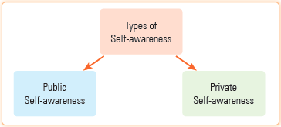
Session 2: Self-Awareness
Self-awareness is the capacity of a person to examine his/her own thoughts or feelings.
One can know various shades of his/her characteristics by being more aware about him/herself.
There are two types of self-awareness, one is public self-awareness and the other one is private self-awareness as shown in Figure.

Slide 11
Session 2: Self-Awareness
Public Self-awareness: The kind of awareness that comes into being when people are at the center of attention, such as giving a presentation or speech at a public gathering. This kind of self-awareness often forces people to follow certain social norms.
Private Self-awareness: The kind of awareness that comes into being when people become aware about themselves and their inner instincts, such as seeing your face in a mirror or introspecting on one’s own conduct.

Slide 12
Session 3: Self-Motivation
Self-motivation is the ability of doing things without the influence of others.
Self-motivated people easily find reasons to complete a task. Such kind of people never give up. They do not need someone to encourage them.
It is of two types, one is intrinsic motivation and the other one is extrinsic motivation.
  Intrinsic Motivation: This kind of motivation makes us perform tasks based on internal satisfaction. Some basic intrinsic motivators are being interested in the task or enjoying the task that you are doing.
  Extrinsic Motivation: This kind of motivation makes us perform tasks to attain a certain kind of reward that may be in terms of money, good marks in an exam or a powerful position in an organization.

Slide 13
Session 3: Self-Motivation
Few points that need to be considered in self-motivation are as follows:
  One should set high but realistic goals.
  One should take calculated risks.
  One should always seek for feedback so that improvements can be made.
  One should be committed towards personal as well as organizational goals.
Self-motivation helps an individual in the following ways:
  It influences the behaviour of individuals positively so that they can give their best to accomplish organizational objectives.
  It encourages individuals to fulfil their own unsatisfied personal goals.
  It helps employees achieve individual, group and organizational goals.

Slide 14
Session 3: Self-Motivation
Some qualities of self-motivated people are as follows:
  They know about their goals in life.
  They are always ready to learn something new.
  They accept positive criticism and work upon their weaknesses.
  They are focused to achieve their goals.
  They know their priorities.
  They believe in themselves and others.
  They find new ways to live better.
  They have visionary thinking.
  They are always ready to face new challenges.

Slide 15
Session 4: Self-Regulation
Self-regulation is the ability to watch and manage our emotions, thoughts and behaviour.
Our behavior should be such that it produces positive results such as well-being and learning.
To develop such an ability, one must be self-aware, emotionally intelligent and able to cope up with stress.
One can learn how to improve self-regulation skills by understanding the functions of emotions.
All emotions have the following three motivations:
  Approach: In this kind of motivation, a person seeks more out of something, such as to discover more or to experience more.
  Avoid: In this kind of emotion, a person wants to run away from everything.
  Attack: In this kind of emotion, a person wants to insult or criticize someone.

Slide 16
Session 5: Self-analysis/Knowing Yourself
Self-analysis (also known as knowing yourself) plays an important role in everyone’s life. It is a process where we have to focus on ourselves completely.
Self-analysis is an understanding of knowing our internal qualities, abilities, strengths and weaknesses.
Knowing yourself is being aware of your strengths and weaknesses. It also means having the knowledge of your positive and negative attributes.
The process of self-discovery is done with conscious effort, intention, and purpose.
Self-analysis helps you to:
  become familiar with your strengths and weaknesses.
  know your desires and fears.
  acknowledge your likes and dislikes.

Slide 17
Session 5: Self-analysis/Knowing Yourself
  identify your limits.
  understand your self-doubt.
  respect your values in life.
  recognize your personality.
Some questions that help you identify your strengths are:
  What do you love to do the most?
  What other people think and talk about you?
  What are your interest areas?
  What knowledge or expertise do you have?
  What are your personal characteristics that you are proud of?

Slide 18
Session 5: Self-analysis/Knowing Yourself
No one is perfect in this world and there is no issue if you have some weaknesses but if you are able to identify your weaknesses and work on that, then you will be able to enhance your skills.
Some questions that help you identify your weaknesses are:
  What you did not want to do?
  What other people say about you?
  What are the areas in which you suffer?
  In which areas, do you procrastinate or feel a lack of energy?

Slide 19
SWOT Analysis
The letters of SWOT stand for Strengths, Weaknesses, Opportunities, and Threats.
In SWOT analysis, strength and weakness are known as internal factors, while opportunities and threats are considered as external factors.
By using the SWOT analysis, you can question yourself and get the best answer that will help in making decisions.
This will help in familiarizing yourself with your strengths and weaknesses and attaining success.

Slide 20
Session 6: Time Management
Time management is the process of organizing time in such a way that you can complete specific activities in an effective manner.
The most important part of time management is to manage yourself so that you can complete all your tasks within a time limit.
A good and effective time management means better productivity and quality.
Some key features of time management are as follows:
  Creating a list of all the tasks
  Arranging all tasks according to their priorities and setting their time limits
  Making proper plans to complete all tasks
  Including short breaks in a plan

Slide 21
Session 6: Time Management
  Following the plans strictly
  Breaking large tasks into parts and managing them according to deadlines
  Delegating some tasks to friends or other team members, if necessary
  Reducing time wastage as much as possible

Slide 22
Steps for Successful Time Management
By following some steps, you can easily manage your time. These steps are as follows:
  Know about your goals, either they are short term or long term, and make a list of them.
  Identify how much time you are having and how you are currently spending your time.
  Prioritize your goals and accordingly categorize them.
  Create daily plan or schedule keeping your goals, available time, and priorities in your mind.
  Include your plan in your daily routine strictly.

Slide 23
Time Management Tips for Students
Time management tips are important to be followed by students for utilizing their time properly. Some of the tips are as follows:
  Identify how long you can study and make proper time schedules accordingly.
  Include additional activities that you like to do in your schedules.
  Make your daily, weekly, and monthly plans separately.
  Create a list of tasks every day and prioritize them.
  Select a separate area for study that is free from any interruptions.
  Make a habit to revise a thing on the same day when you read it.
  Follow your plans strictly.
  Remind yourself of your ambitions regularly.

Slide 24
Session 7: Goal Setting
Goal setting is the process of finding any task or activity that you want to accomplish within a particular time frame.
Goal setting is the formulation of specific, challenging and clearly-defined goals for an individual, group, or employee.
Goal setting specifies how you progress in your life and what you want to be in future.
Goal setting of individuals can differ based on their living style, requirements, and values.
With the help of the SMART method, you can set your goal.
The SMART method is used to set and achieve your goals on the Specific, Measurable, Achievable, Relevant, and Time-bound criteria.

Slide 25
Thank You

