Slide 1
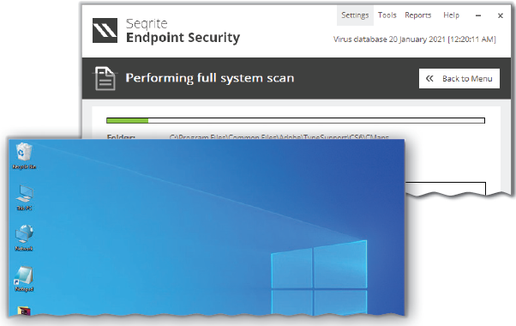
Information and Communication Technology Skills-II
Unit 3

Slide 2
Learning Objectives
This Unit Covers:
Basic Components of a Computer System
Operating System
Windows Operating System
Common Desktop Operations
Understanding the Concept of Files and Directories
Working with Files and Folders
Creating File or Folder in Ubuntu Operating System
Maintenance of Computer
Data Security
Protection from Viruses Using Antivirus

Slide 3
Introduction
An operating system is a system software that manages computer hardware by acting as an intermediary between the user and the hardware.
The operating system for mainframe computers is designed to optimize the utilization of computer hardware.
The operating system for personal computer supports complex games and provides a good interface to a single user.
The operating system for handheld computers are designed to give an environment where a user can easily interact with a computer.
Some operating systems are designed to be convenient and some for efficiency and some for a combination of both.

Slide 4
Session 1: Basic Components of a Computer System
A computer is an electronic device, which is used to perform a variety of operations on the basis of a set of instructions called a program.
The various components of a computer are as follows: the input unit, the processing unit, the output unit and the storage unit.
The physical components of a computer system, such as keyboard, mouse and monitor, are called hardware.
The programs or applications that provide instructions to a computer to carry out a particular task are known as software.
The devices that let you enter data or instructions in a computer are known as input devices.
Some examples of input devices are keyboard, mouse, scanner, bar code reader, joystick, microphone, Web camera, etc.

Slide 5
Session 1: Basic Components of a Computer System
An output device is an electronic equipment that is connected to a computer and is used to communicate results of the processed data to the user.
Some examples of input devices are monitor, printer, and speaker.
Memory is the area where you can store information.
Primary memory is the main memory in a computer system where data is stored for quick access by the CPU. This type of memory stores the data temporarily.
To store the data permanently, you need to use secondary memory. The secondary memory is also known as the secondary storage.
The storage capacity of secondary memory devices is measured in terms of KBs, MBs, GBs and TBs.

Slide 6
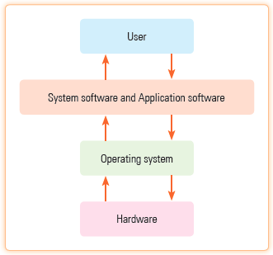
Session 2: Operating System
An operating system is a system software that acts as an interface between the user and computer hardware as shown in Figure.
An operating system is a specialized set of programs that is used to manage the resources of a computer as well as to control and monitor the execution of other programs.

Slide 7
Types of Operating System
There are various types of operating systems as follows:
Batch Operating System: The operating system where programs are collected in a batch or a group before the execution starts is called a batch operating system.
Multiprogramming Operating System: The operating system where two or more programs are in the memory at the same time, they share the processor is called multiprogramming operating system.
Multi-processor Operating System: The operating system where more than one processor share a common clock, input-output memory, system clock and sometimes memory also is called multi-processor operating system.

Slide 8
Session 2: Operating System
Distributed Operating System: The operating system which runs on multiple machines and also controls the resources at remote sites is called distributed operating system.
Clustered Operating System: The operating system in which computer systems are connected to a high speed common link and each system has its own peripheral devices and memory is called clustered operating system.
Real-time Operating System: Such kind of operating system must react to inputs and respond to them quickly such as autonomous systems.

Slide 9
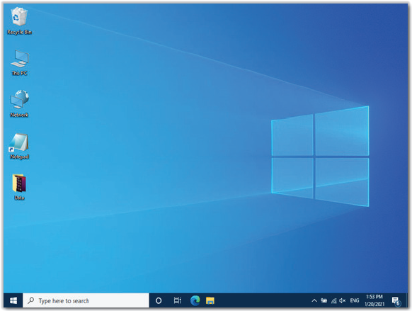
Session 3: Windows Operating System
In Windows environment, the desktop generally contains one or more small images, called icons, as shown in Figure.
An icon is a symbolic representation of a drive, folder, file, program or tool.
Labels give a short description about the program that the icon represents.
The desktop icons allow to open or start the corresponding programs directly by double-clicking them.

Slide 10
Session 4: Common Desktop Operations
There are a number of operations that can be performed on the desktop of a computer are as follows:
Adding Icons on the Desktop: Perform the following steps to add an icon on the desktop:
Right-click anywhere on the empty space of your desktop. A context menu appears.
Select the Personalize option from the context menu.
The Personalization page displays on the Settings window.
Select the Themes option in the Personalization page.
The options related to the theme of the Windows 10 appear.
Click the Desktop icon settings link available under the Related Settings section.

Slide 11
Session 4: Common Desktop Operations
The Desktop Icon Settings dialog box opens. By default, the Recycle Bin check box is selected.
Select the Computer and Network check boxes.
Click the Apply button to apply the settings that you have selected.
Click the OK button.
The Desktop Icon Settings dialog box closes and the Personalization page gets activated.
The new icons labeled This PC and Network appear on the desktop.

Slide 12
Session 4: Common Desktop Operations
Adding Shortcut Icons on the Desktop: Perform the following steps to add the shortcut icon of the Notepad program on the desktop.
Select Start → Windows Accessories. A list of programs appears.
Drag the Notepad option to the desktop to create the shortcut icon of the Notepad application.
The shortcut of the Notepad program appears on the desktop.

Slide 13
Session 5: Understanding the Concept of Files and Directories
In the computer system, the disk drive is divided into directories.
Each directory is further divided into sub-directories, and each sub-directory may also be divided into its sub-directories.
A file, in the context of a computer system, is a named collection of data stored on a storage device.
Each file possesses some features and attributes, such as file name, file type or file access permission. To group similar types of files together, we create a directory and place those files in that directory.
A directory may contain files as well as other subdirectories. This type of organized file structure is known as a multilevel or hierarchical directory structure.
The Windows operating system follows a different structure consisting of partitions that contain directories.

Slide 14
Session 6: Working with Files and Folders
In the absence of a computer, you use paper sheets to write important information.
You prefer to organize your paper sheets containing important information in a book form.
In computer terminology, a file is similar to a paper sheet and a folder is similar to a book.
As a book contains pages, a computer folder consists of files. Windows 10 allows you to organize your files, folders and documents according to your preferences.
To arrange your documents, you can store the related files in one folder.
In addition, you can open, edit, rename or delete the files and folders with the help of mouse and keyboard.

Slide 15
Creating and Saving a File
Let’s create a file in Notepad, which is a text editor program used to write short letters, memos and create text files. Perform the following steps:
Click the Start button present on the Taskbar. The Start menu appears.
Click the Windows Accessories folder from the list of programs. A list of options available under Windows Accessories appears.
Select the Notepad option. The Notepad file gets opened.
Enter some information in the file.
Click the File menu from the Menu bar.
Select the Save option from the drop-down menu. The Save As dialog box appears.
Enter the desired file name in the File name combo box.
Click the Save button.

Slide 16
Creating a Folder
In Windows 10, you can create new folders by using the File Explorer window.
You can create a folder by clicking the New folder button in the Home tab or right-clicking the blank area of the File Explorer window and then selecting New → Folder from the context menu.
One has to perform the following steps to create a folder:
Navigate to the drive or location where you want to create a new folder.
Click the New folder button under the New group of the Home tab.
Type the desired name for the folder.
Press the Enter key. The newly created folder is displayed on the desktop.

Slide 17
Renaming Files and Folders
Sometimes, you may want to rename a file or folder by giving it a purposeful new name.
Perform the following steps to rename a file or folder:
Navigate to the location where the file or folder that you want to rename is saved.
Right-click the folder or file that you want to rename. A context menu appears.
Select the Rename option from the context menu.
The name of the selected file or folder appears in the edit mode.
Enter the new name for the file of folder.
Press the Enter key. The file or folder gets renamed.

Slide 18
Deleting Files and Folders
Perform the following steps to delete a file or folder:
Open the File Explorer window.
Select the file or folder that you want to delete.
Press the Delete key from the keyboard.
The file or folder gets deleted from the location and moved to recycle bin.
Perform the following steps to delete a file or folder by using the permanently delete option:
Open the File Explorer window.
Navigate to the location where the file or folder is stored.
Select the file or folder that you want to delete permanently.
Click the down arrow of the Delete button under the Organize group of the Home tab. A drop-down list appears.

Slide 19
Session 6: Working with Files and Folders
Select the Permanently delete option from the drop-down list.
The Delete Folder message box appears, prompting you to confirm deletion of data permanently.
Click the Yes button in the Delete Folder message box to delete the selected folder permanently. The folder gets deleted.
The Recycle Bin allows you to retrieve a deleted file. To restore a file from the Recycle Bin, you need to perform the following steps:
Double-click the Recycle Bin icon on the desktop. The Recycle Bin window appears.
Right-click the file or folder in the Recycle Bin window that you want to restore. A context menu appears.
Select the Restore option from the context menu.

Slide 20
Session 7: Creating File or Folder in Ubuntu Operating System
Ubuntu allows you to organize your files, folders, documents and programs according to your preferences.
Now, perform the following steps to create and save a file in Text Editor:
Click the Show Applications button. A grid of applications installed on the system displays on the desktop in the form of icons.
Click the Text Editor icon from the grid of applications. The Text Editor window appears.
Type some text in the file.
Click the Save button. A dialog box appears to save the file.
Specify the location where you want to save the file.
Enter the file name in the Name text box.
Click the Save button.
The file gets saved with the entered name and at the selected location in your computer.

Slide 21
Session 8: Maintenance of Computer
Maintenance of computer is the practice of keeping a computer dust and debris-free.
It is necessary to keep the components of a computer clean as it helps in their smooth functioning.
Some computer components that require regular cleaning are CPU, keyboard, monitor and mouse.
A computer needs regular maintenance to keep things running.

Slide 22
Session 9: Data Security
Data security is the process of ensuring the safety of data from unauthorised users.
Data security is the process of ensuring the integrity, availability and confidentiality of computer data and resources against various types of threats, such as unauthorized access, viruses, bugs and vulnerability.
You can keep the data and applications safe and secure from unauthorised access and threats by using security mechanisms.
Some security mechanisms are as follows:
Antivirus Software: Antivirus software can be referred to as an application that can be used as a primary method for preventing malicious codes and viruses.
Username and Password: A username is a unique identity of a person to access the computer system, network and online accounts. A password is a secret string that is generally used for gaining access to some devices.

Slide 23
Session 9: Data Security
Cryptography and Encryption: Cryptography makes sure that data gets transferred securely over an unsecured network such as the Internet. To ensure secure transmission, data is sent in such a way that it looks completely different from the original data. In cryptographic terms, data that is to be secured is called plaintext or cleartext and the data after encryption is called ciphertext. The process of converting a plaintext into ciphertext is called encryption.
Digital Signatures: A digital signature or digital signature scheme is a mathematical approach used for authenticating a digital message or a document.
Firewall: Firewall is the hardware or software of a computer system that is designed to inspect the incoming and outgoing network traffic and alter the traffic flow by dropping or passing certain packets. Certain rules and criteria are set in the firewall on the basis of which the firewall allows or denies the network transmission.

Slide 24
Session 10: Protection from Viruses Using Antivirus
Protecting a computer from viruses is one of the important aspects of computer security.
Providing security to a computer is important as it will protect information from unwanted sources such as virus and worms.
A virus is a harmful program, which on entering a computer starts creating copies of itself. It then attacks by corrupting the executable files and folders saved on the computer.
There are three types of virus such as file infectors, boot sector viruses and macro viruses.

Slide 25
Antivirus Software
Antivirus software is used to identify, prevent, and take action against malicious programs, such as viruses and worms, by deactivating or deleting them.
It is recommended to purchase a genuine copy of antivirus software as it includes future support for computer, including the opportunity to update the software against new virus threats and various additional features.
Some popular antivirus software are Norton Antivirus, McAfee, Smart cop, etc.

Slide 26
Scanning a Virus
Now, let’s scan an entire hard disk drive or partition. In our case, we will scan the entire hard disk drive with the help of the Seqrite Endpoint Security antivirus application powered by Quick Heal Technology Ltd.
Perform the following steps to scan the entire hard disk drive or a hard disk partition:
Open the Seqrite Endpoint Security antivirus software application. The Seqrite Endpoint Security dialog box opens.
Select the Scan option. A drop-down list appears.
Select the desired option to scan your computer.
The Seqrite Endpoint Security dialog box displays the scanning process
Click the Close button in the Seqrite Endpoint Security dialog box when the scanning is completed.

Slide 27
Session 11: Starting and Shutting Down a Computer
You can switch on your computer by performing the following steps:
Switch on the electricity button.
Switch on the UPS power button.
Switch on the CPU power button.
Switch on the monitor power button.
The computer boots and displays the windows login screen.
Login to the computer by entering the required credentials.
Perform the following steps to shut down a computer in Windows 10:
Click the Start button to open the Start menu.
Click the Power button on the bottom-right corner of the Start menu. A drop-down list appears.
Select the Shut down option on the Start menu for shutting down the computer.

Slide 28
Thank You

