Slide 1
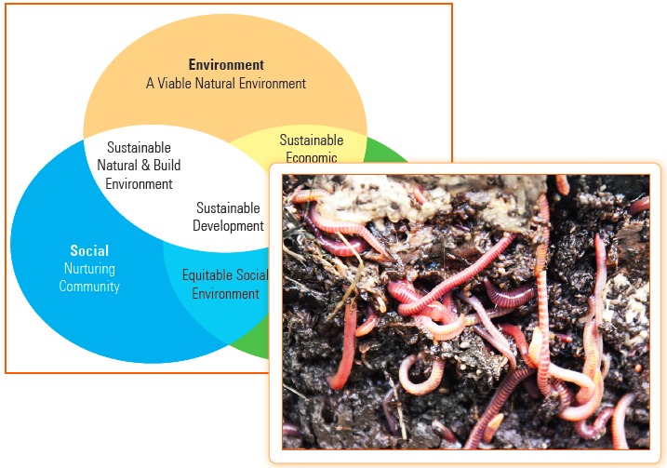
Green Skills – II
Unit 5

Slide 2
Learning Objectives
This Unit Covers:
Sustainable Development
Sustainable Development Goals (SDGs)
Green Economy
Environmental Citizenship

Slide 3
Introduction
Green skills are also known as skills for sustainability.
The development of green skills is important to ensure that human beings live and work in an environmentally responsible manner and are able to deal with the impacts of environmental damage.
Green skills can be applied to various fields such as renewable energy, water management, waste management, energy conservation, pollution control and green construction.

Slide 4
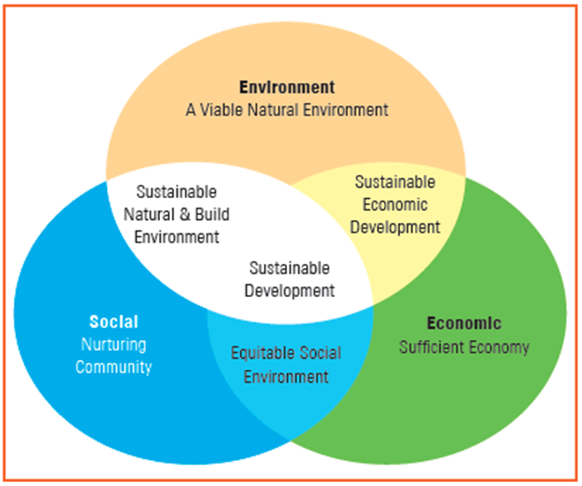
Session 1: Sustainable Development
Sustainable development refers to a developmental approach which takes into account the fact that the natural resources present in the world are limited and must be used judiciously.
Sustainable development requires making the maximum use of renewable energy resources, such as wind power and solar power.
The three main areas in which sustainable development needs to be pursued are shown in Figure.

Slide 5
Importance of Sustainable Development
It is very important to practice sustainable development because of the following reasons:
Promoting proper use of resources
Developing positive attitude
Increasing participation of people in development activities

Slide 6
Problems Related to Sustainable Development
Some of the important challenges or problems related to sustainable development are as follows:
Corruption
Lack of Effort
Lack of Financial Resources
Natural Calamities

Slide 7
Popular Methods of Sustainable Development
Sustainable development can be achieved by implementing various types of programs or by using certain technologies or methods. These are as follows:
Rain Water Harvesting
Drip/Sprinkler Irrigation
Vermicomposting
Solar Energy

Slide 8
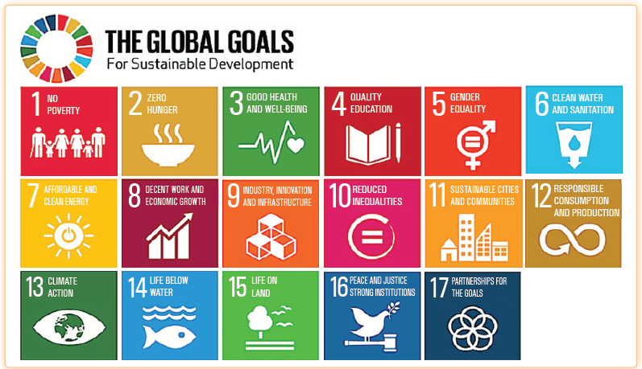
Session 2: Sustainable Development Goals (SDGs)
In 2015, all the members of the United Nations (UN) approved the 17 sustainable development goals (SDGs) to be achieved till year 2030.
The following figure shows the global sustainable development goals:

Slide 9
Session 2: Sustainable Development Goals (SDGs)
These SDGs are categorized into three areas, which are economic, environmental, and social.
SDG 1, SDG 2, SDG 3, SDG 8 and SDG 9 are related to the economic area.
SDG 6, SDG 7, SDG 12, SDG 13, SDG 14, and SDG 15 are related to the environmental area.
SDG 4, SDG 5, SDG 10, SDG 11, SDG 16, and SDG 17 are related to the social area.

Slide 10
Session 3: Green Economy
Green economy is an economy that is in line with the principles of sustainable development. A green economy has the following characteristics:
It has low carbon.
It is resource efficient.
It is socially inclusive
According to the United Nations Environment Programme (UNEP), green economy is the one that results in improved human well-being and social equity, while significantly reducing environmental risks and ecological scarcities.
One of the major challenges in developing and promoting a green economy is to determine the approaches to economy and environment in order to give people the quality of life they seek.

Slide 11
Importance of Green Economy
Some points that demonstrate the importance of green economy are:
It helps in moving from economic growth to balanced growth.
It helps in achieving biological balance.
It makes it possible to account for environment and sustainability.
It views nature as capital.
It clearly presents the tradeoffs between the environment and the economy.
It makes it possible to shift to responsible resource utilization.

Slide 12
Session 4: Environmental Citizenship
Environmental citizenship is a key idea which suggests that human beings are an integral part of the environment and also recognizes that the future of human beings is intricately associated with ecosystems.
The concept of environmental citizenship also lays out that it is our responsibility to take concrete steps to protect and conserve the environment.
The concept of environmental citizenship explains that each one of us should try to become an environmental citizen.
Some of the practices that are promoted under environmental citizenship include:
Adopting a Green Lifestyle:
Participating in Environmental Decision-making
Fixing the Responsibility and Accountability of Businesses

Slide 13
Session 4: Environmental Citizenship
Environmental citizens also have certain rights such as:
Right to environmental information
Right to justice in environmental matters
Clean and healthy environment

Slide 14
Thank You

