Slide 1
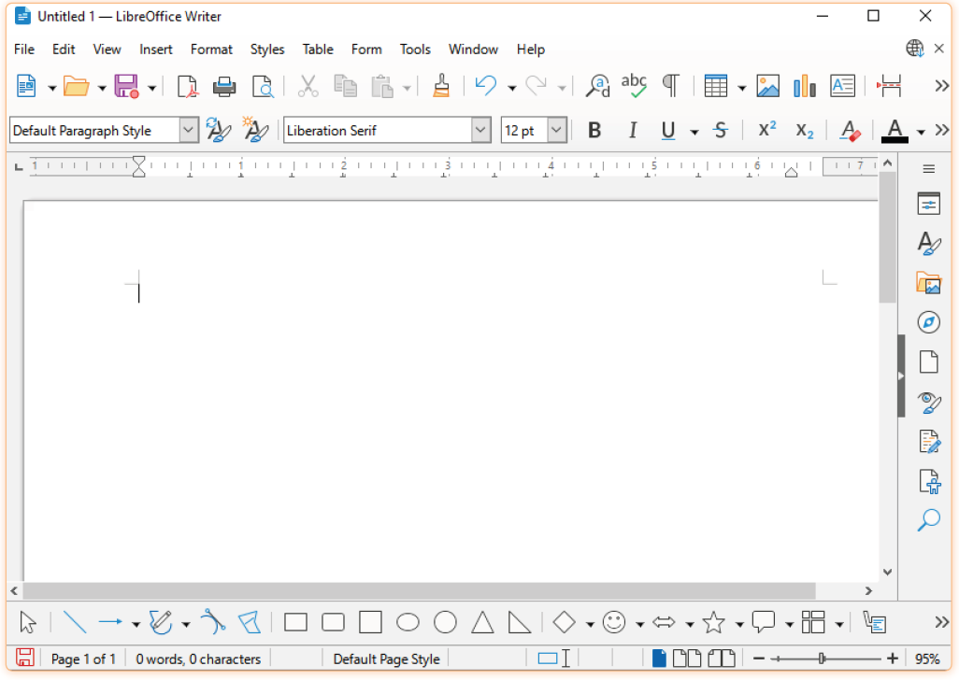
Digital Documentation (Advanced)
Unit 6

Slide 2
Learning Objectives
This Unit Covers:
Creating, modifying and applying styles
Inserting, modifying, and resizing images
Inserting, resizing, grouping drawing objects
Aligning and arranging graphical objects
Creating, editing, importing and exporting templates
Creating, customizing, and maintaining a table of contents (TOC)

Slide 3
Introduction
LibreOffice Writer is a word processor, which is used to create and edit textual documents.
In LibreOffice Writer, you can format the text and paragraph that make a document more attractive and professional looking.
A style can be defined as a collection of formatting attributes that can be applied to the items throughout a document.
LibreOffice Writer facilitates you to add graphical objects, such as image and drawing objects in a document to enhance the appearance of the document.
LibreOffice Writer also provides some advanced features, such as template and table of contents.
A template is a pattern or model that can be used as a guide to make something in the predefined structure.
A table of contents (TOC) displays the relevant text or content in a tabular form in the order in which the text or content appears in the document.

Slide 4
Session 1: Working with Styles
While entering text in a document in LibreOffice Writer, you need not be concerned about determining the appropriate formatting to apply on the text.
There is a wide variety of predefined styles in LibreOffice Writer, which you can easily and quickly apply on the text to give a consistent look to the documents.
Styles are predefined formatting instructions applied to text, paragraphs, tables, or pages, saving time and ensuring uniformity by avoiding repeated manual formatting.
They control how text, paragraphs, frames, pages, and lists appear, including font type, size, colour, alignment, line spacing, and indentation.
Using styles allows you to quickly apply uniform formatting without manually changing each element, saving time and reducing errors.

Slide 5
Categories of Styles in LibreOffice Writer
Different styles available in LibreOffice Writer are:
Paragraph styles
Character styles
Frame styles
Page styles
List styles
Table styles

Slide 6
Applying Style to a Document
There are various types of predefined styles in LibreOffice Writer.
The availability of styles depends on the template on which the document is based. Applying styles to a document in LibreOffice Writer helps maintain consistency and enhances the visual appeal of the content.
Applying styles to a document means formatting different parts of your text, such as headings, paragraphs, lists, and tables, consistently and efficiently.
It ensures uniform appearance across the document, making it professional, readable, and easier to edit.
We use this approach to save time, maintain consistency, and quickly update
formatting throughout the document without manually changing each section.

Slide 7
Applying Style to a Document
In LibreOffice Writer, you can apply the styles in various ways, which are as follows:
Using the Styles Sidebar
Using the Fill Format Mode
Using the Apply Style list
Using the Shortcut key

Slide 8
Popular Methods of Sustainable Development
Sustainable development can be achieved by implementing various types of programs or by using certain technologies or methods. These are as follows:
Rain Water Harvesting
Drip/Sprinkler Irrigation
Vermicomposting
Solar Energy

Slide 9
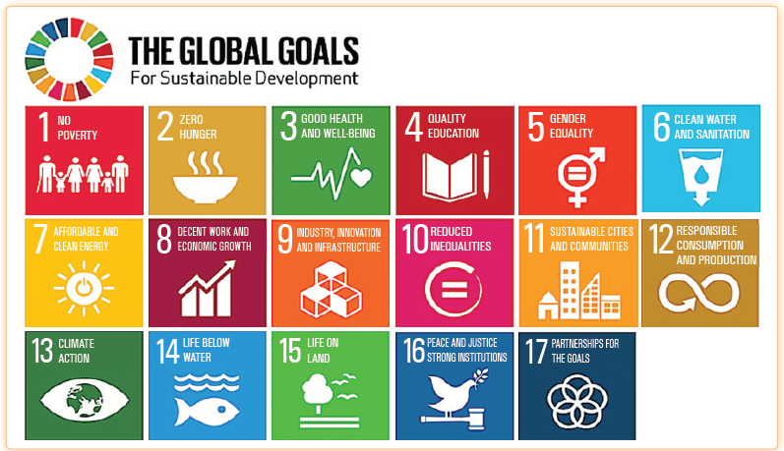
Session 2: Sustainable Development Goals (SDGs)
In 2015, all the members of the United Nations (UN) approved the 17 sustainable development goals (SDGs) to be achieved till year 2030.
The following figure shows the global sustainable development goals:

Slide 10
Session 2: Sustainable Development Goals (SDGs)
These SDGs are categorized into three areas, which are economic, environmental, and social.
SDG 1, SDG 2, SDG 3, SDG 8 and SDG 9 are related to the economic area.
SDG 6, SDG 7, SDG 12, SDG 13, SDG 14, and SDG 15 are related to the environmental area.
SDG 4, SDG 5, SDG 10, SDG 11, SDG 16, and SDG 17 are related to the social area.

Slide 11
Session 3: Green Economy
Green economy is an economy that is in line with the principles of sustainable development. A green economy has the following characteristics:
It has low carbon.
It is resource efficient.
It is socially inclusive
According to the United Nations Environment Programme (UNEP), green economy is the one that results in improved human well-being and social equity, while significantly reducing environmental risks and ecological scarcities.
One of the major challenges in developing and promoting a green economy is to determine the approaches to economy and environment in order to give people the quality of life they seek.

Slide 12
Importance of Green Economy
Some points that demonstrate the importance of green economy are:
It helps in moving from economic growth to balanced growth.
It helps in achieving biological balance.
It makes it possible to account for environment and sustainability.
It views nature as capital.
It clearly presents the tradeoffs between the environment and the economy.
It makes it possible to shift to responsible resource utilization.

Slide 13
Session 4: Environmental Citizenship
Environmental citizenship is a key idea which suggests that human beings are an integral part of the environment and also recognizes that the future of human beings is intricately associated with ecosystems.
The concept of environmental citizenship also lays out that it is our responsibility to take concrete steps to protect and conserve the environment.
The concept of environmental citizenship explains that each one of us should try to become an environmental citizen.
Some of the practices that are promoted under environmental citizenship include:
Adopting a Green Lifestyle:
Participating in Environmental Decision-making
Fixing the Responsibility and Accountability of Businesses

Slide 14
Session 4: Environmental Citizenship
Environmental citizens also have certain rights such as:
Right to environmental information
Right to justice in environmental matters
Clean and healthy environment

Slide 15
Thank You

